Slide 1
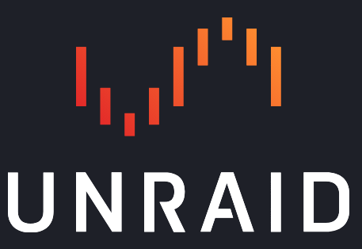
Notes:
There are software platforms available to use to transform common computer hardware into a fully functional NAS.
Today we’re going to talk about 2 of them. TrueNAS SCALE and Unraid.

Slide 2
Introduction to TrueNAS SCALE
Jason Paul
March 4, 2024

Slide 3
How many of you have some kind of network attached storage? What kind of solution?
Notes:
Ask audience if they’re currently using a NAS, and what kind. Ask to put in chat.

Slide 4
Who is Jason Paul?
Born in Winnipeg, MB.
Been using Linux since 2001.
Living in Waterloo Region since 2004.
Find out more about me at my website: https://www.linuxtek.ca/
Connect with me on LinkedIn: https://www.linkedin.com/in/jason-paul-it/

Slide 5
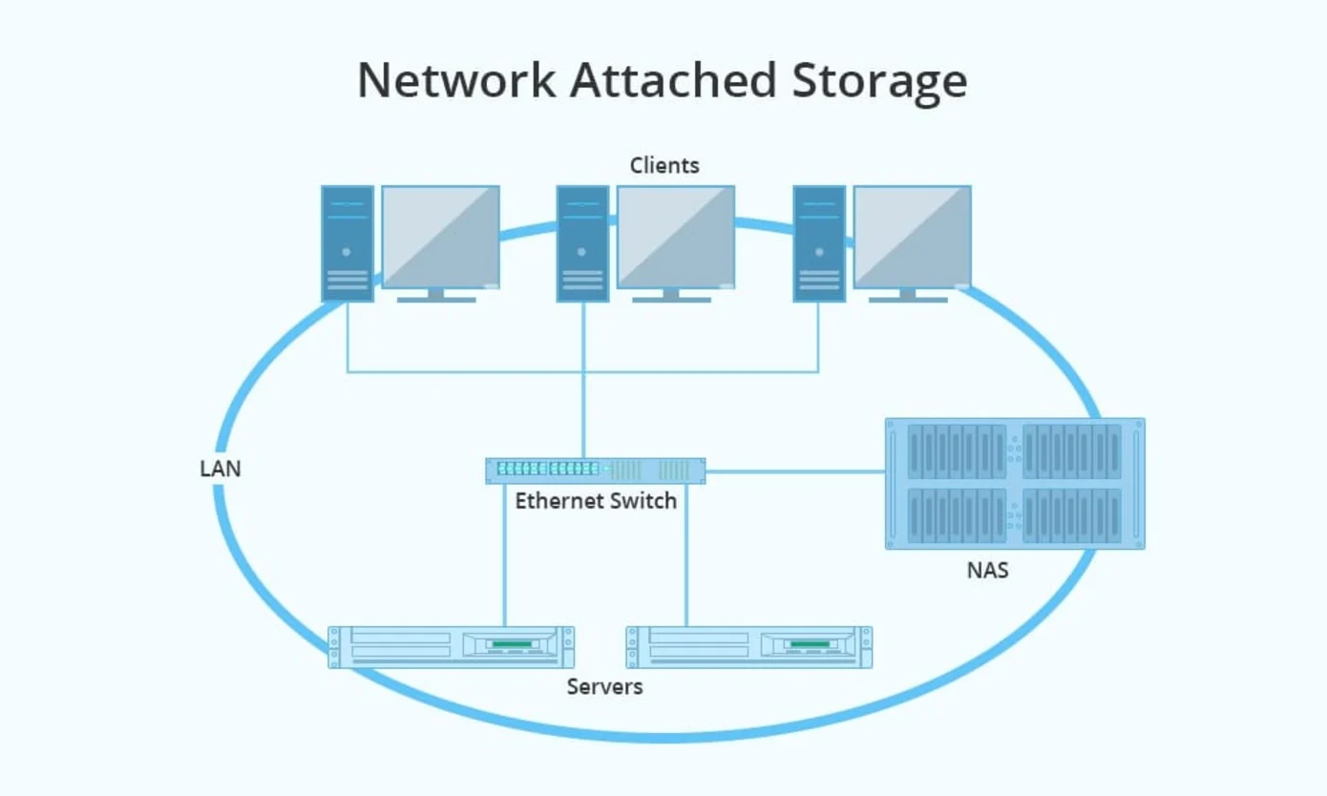
What is a NAS?
Notes:
File-level computer data storage server.
Network connected available storage for both clients and servers.
Files typically shared using a network communication protocol like SMB, NFS, FTP, etc.
Modern NAS typically enough enough resources to host some applications and run other tasks.

Slide 6
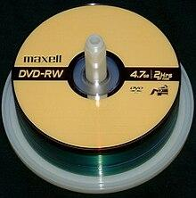
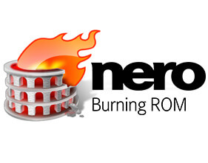
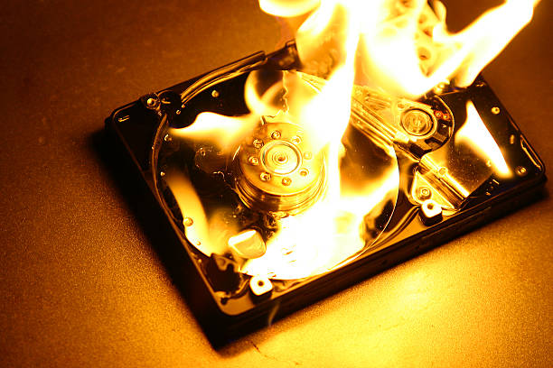
Why use a NAS?
Notes:
Removes the capacity limitation of your computer’s local storage.
Faster access to your files. No need to find a portable HD, DVD or USB stick with the files you need.
Automated backup, with redundancy to withstand one or more hard drive failures.
Hard drives are a matter time until failure.
Ability to share files on your local network, host and run applications.

Slide 7
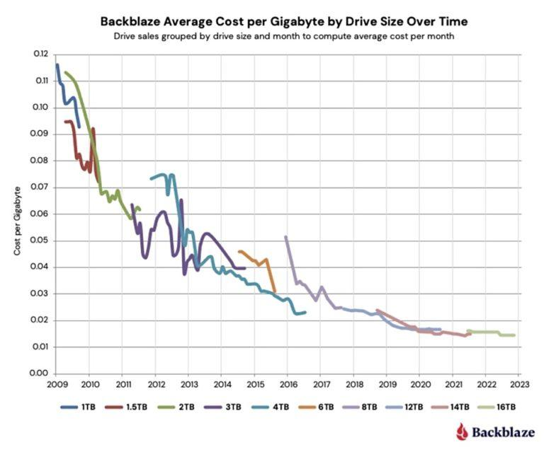
Notes:
Traditional spinning disk hard drive storage has become progressively inexpensive. Disks are getting larger and larger.
Cost per GB has decreased.
Older computer hardware can easily be converted into a NAS.

Slide 8
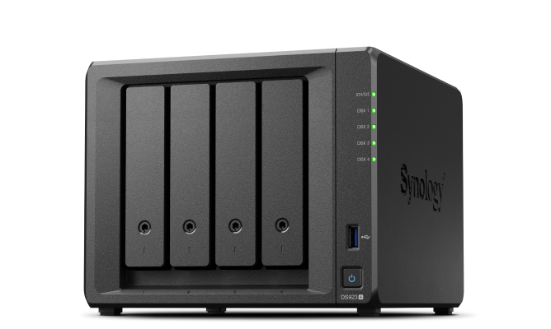
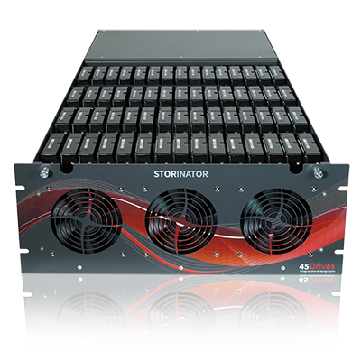
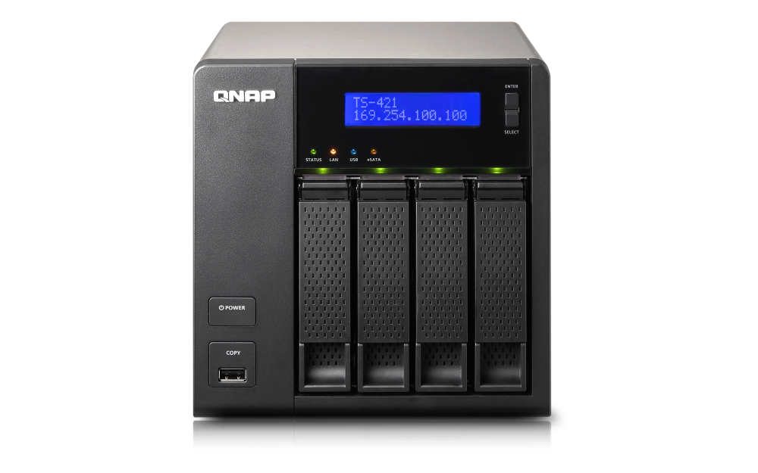
Commercial NAS Offerings
Notes:
Home units from Synology, QNAP, Western Digital, NetGear
Enterprise offerings from Dell, HP, Lenovo
Shoutout to my boys at 45 Drives!

Slide 9
What is TrueNAS?
Notes:
Open Source, Hyperconverged Infrastructure Solution
Free to download and use, Open Source, Built on Debian Linux
Built on the OpenZFS filesystem

Slide 10
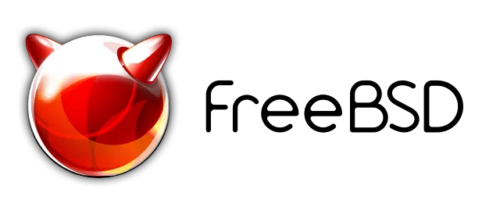
TrueNAS Project Timeline
2005
2020
2022
Notes:
Initially started in 2005 as FreeNAS Project.
Based on the m0n0wall embedded firewall and FreeBSD 6.0
Rebranded to TrueNAS CORE in March 2020.
Debian Linux based product announced in October 2020 - TrueNAS SCALE
TrueNAS SCALE made generally available in February 2022

Slide 11
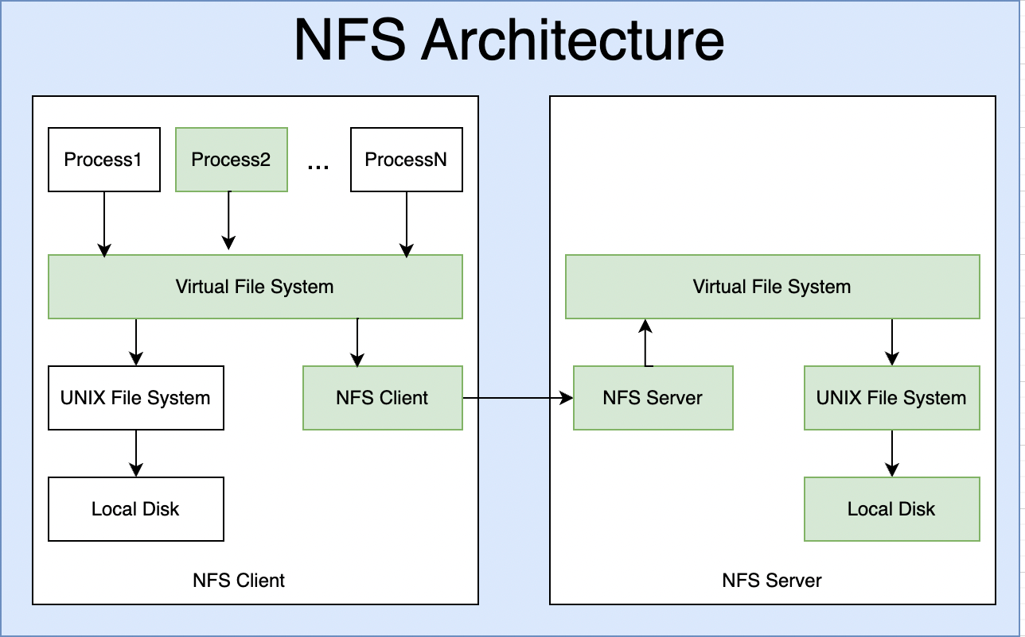
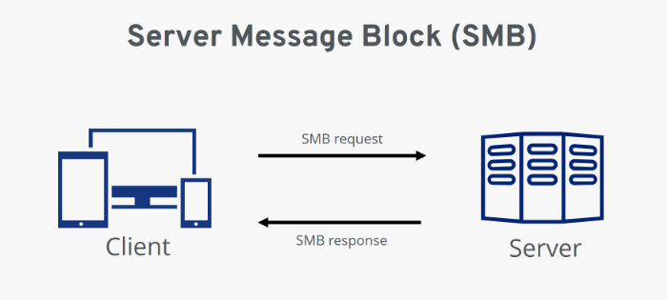
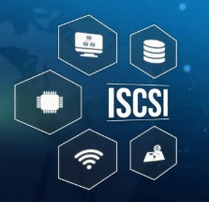
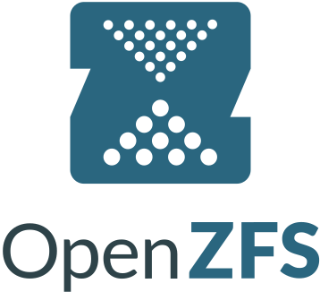
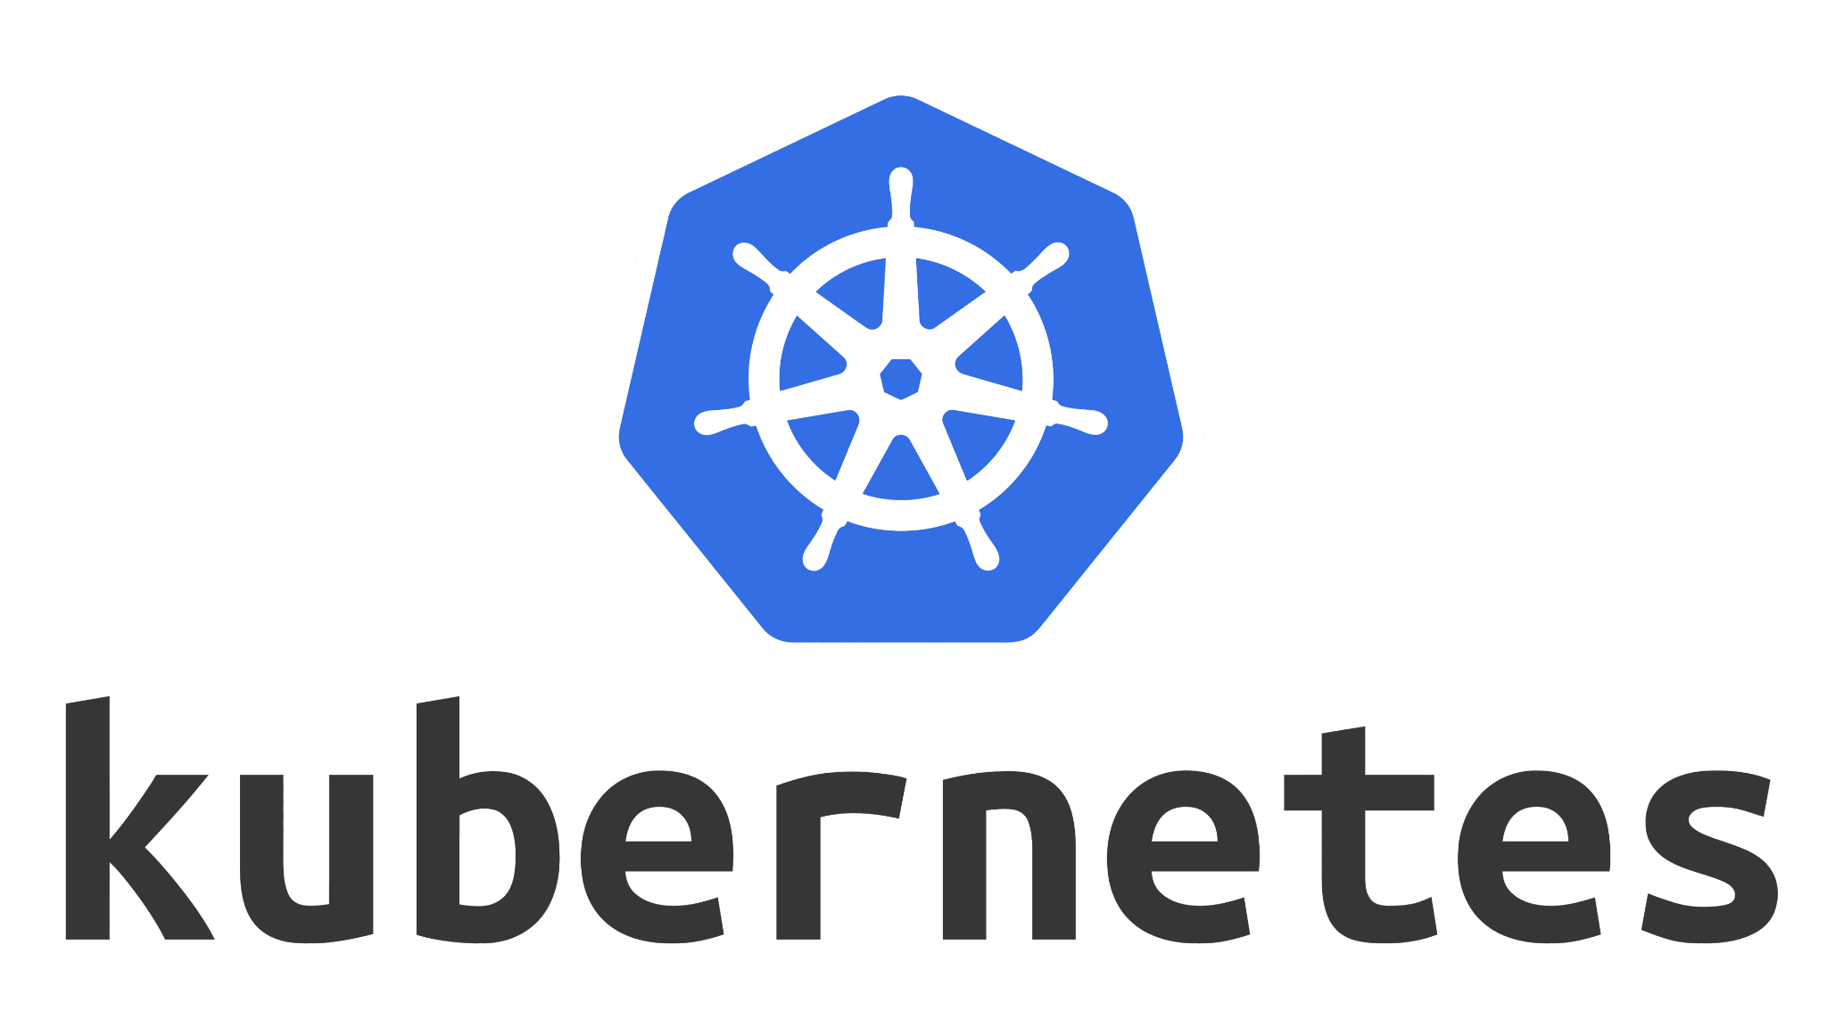
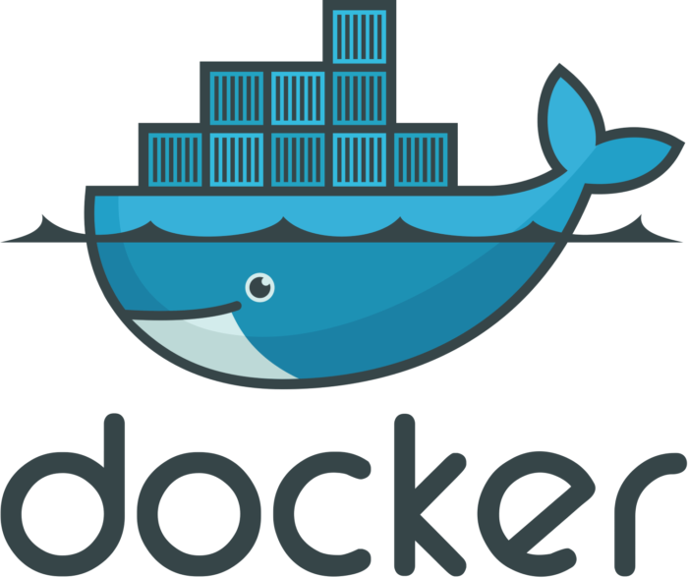
TrueNAS SCALE Features
Notes:
Share files via Windows SMB 2 and 3
Share files via UNIX NFS v3/v4/v4.1
Block level storage via iSCSI
Data replication via rsync and ZFS snapshots
Cloud Sync Tasks to send, receive, or synchronize (backup) with a cloud storage provider.
Supports Amazon S3, Backblaze B2, Box, Dropbox, Google Cloud Storage, Google Drive
Virtual Machines using KVM
Applications using Docker and Kubernetes (k3s)

Slide 12
Quick Primer on ZFS
Pooled storage
Copy-on-write
Snapshots
Data integrity verification and automatic repair
RAID-Z (no RAID controller)
Maximum 16 Exabyte file size
Maximum 256 Quadrillion Zettabytes storage
Notes:
Open-source storage platform.
Uses copy-on-write at the filesystem and disk-management level.
If you write a file, it writes out a new version of the block you modified, then updates the file's metadata to unlink the old block, and link the new block you just wrote.
This prevents problems where a write can be interrupted by power loss and cause filesystem corruption and inconsistency (RAID write hole)
Protection against data corruption via integrity checking for both data and metadata.
Continuous integrity verification and automatic “self-healing” repair.
High storage capacities, space saving with transparent compression.
Can increase data pools, supports hot-spares.
Local and remote replication - send only changed blocks

Slide 13
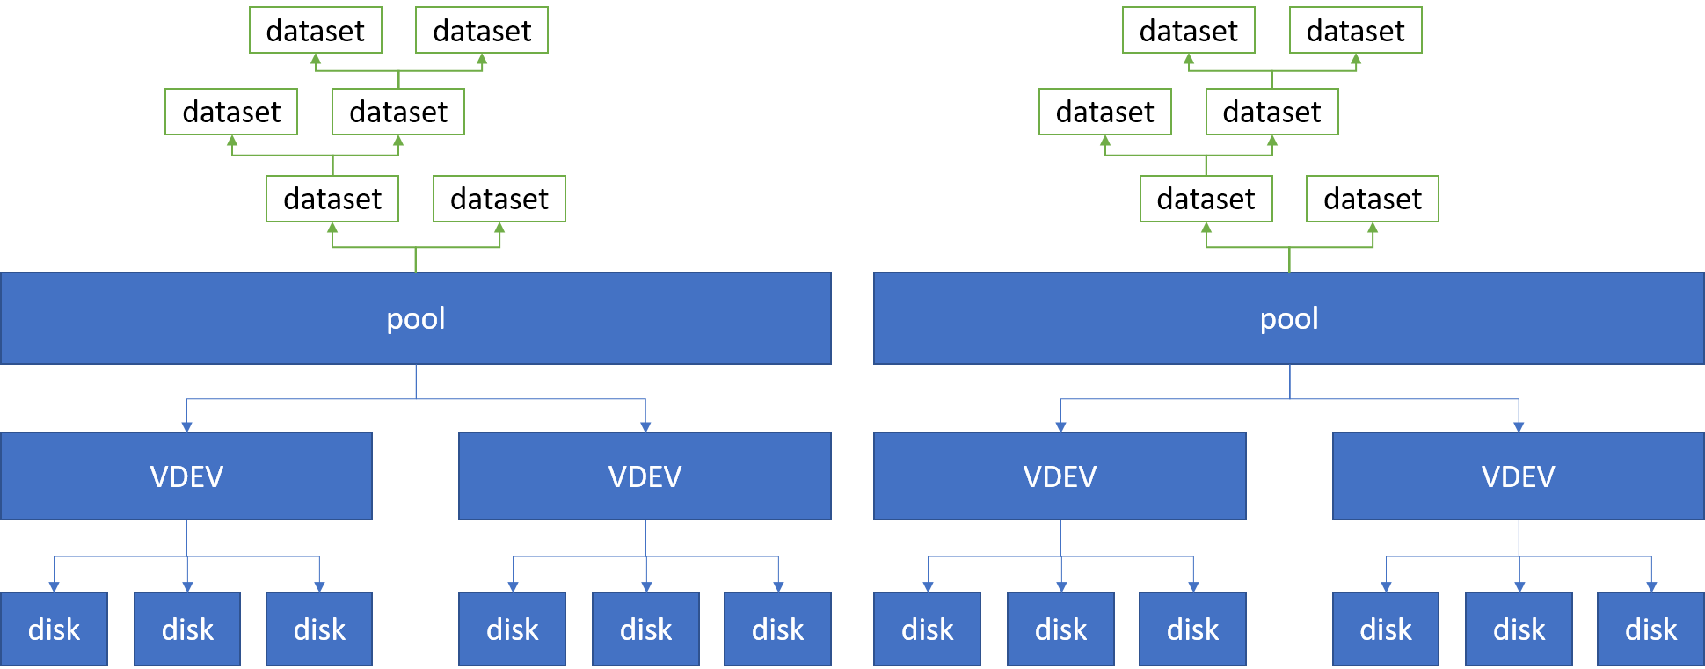
ZFS Data Architecture
Notes:
VDEV (virtual device) is a cluster of disks, typically via software RAID to manage redundancy.

Slide 14
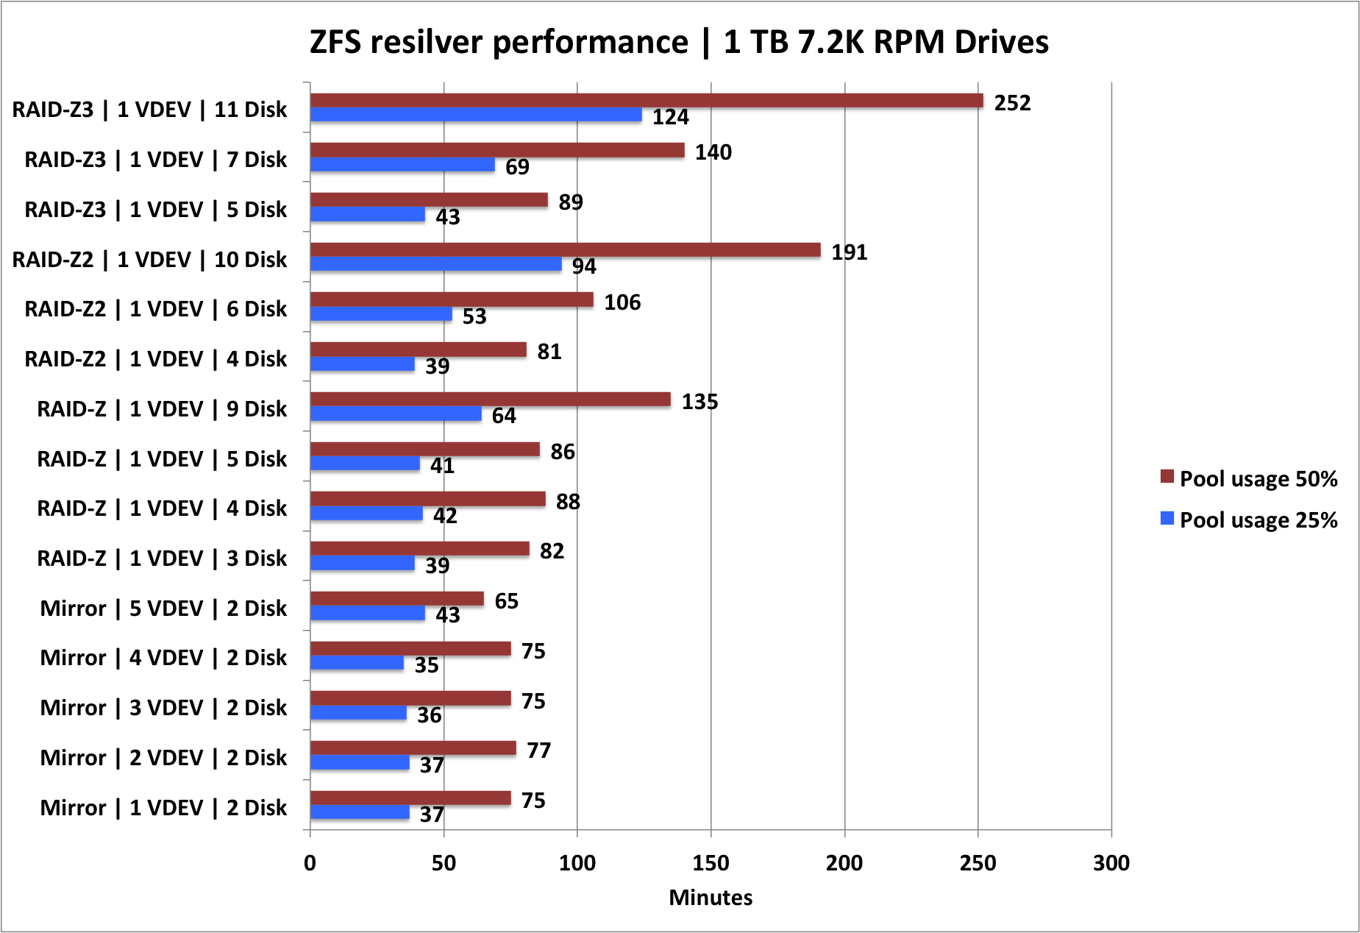
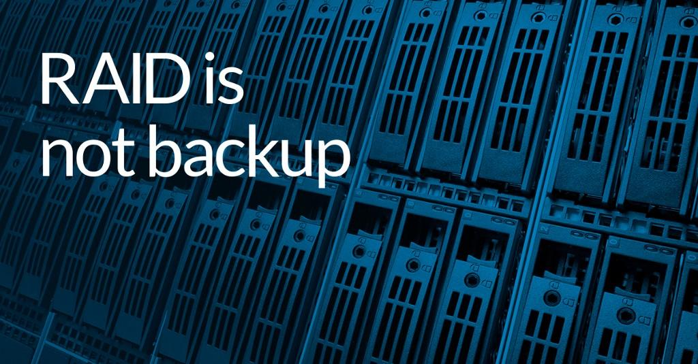
ZFS VDEV Types
VDEV is a cluster of disks. Supports variation of RAID.
Stripe (RAID-0)
Mirror (RAID-1)
RAID5 (RAID-Z1)
RAID6 (RAID-Z2, RAID-Z3)
RAID10 (Mirroring + Striping)
Notes:
RAID0: Combine multiple disks for read/write. If one disk fails, all data lost
RAID1: All data mirrored on multiple drives. More wasted space, but more redundancy in case a drive fails.
RAID5: Parity blocks with data spread across drives. If one disk in a VDEV fails, it can be rebuilt using parity data on the other disks.
RAID6: Two or three drives of parity data, can withstand multiple disks failing.

Slide 15
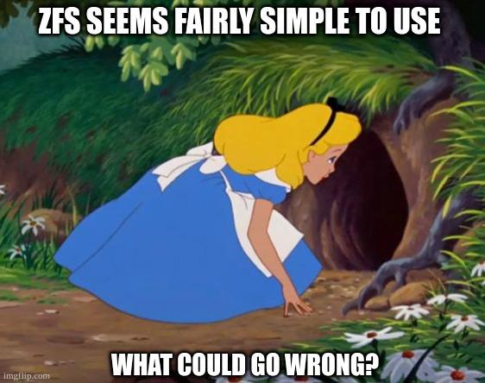
ZFS Performance Tuning
ZFS Caching
ARC - Adaptive Replacement Cache (RAM)
L2ARC - Level 2 ARC (SSD)
ZIL - ZFS Intent Log
SLOG - Separate Log (Write-Cache)
More Terminology
Special VDEV Classes (Log, Cache, Special, Spare)
ZPool Scrubbing
Resilvering
Data deduplication
Notes:
ARC/L2ARC Read Caches
Synchronous vs Asynchronous Writes
TrueNAS will run a scrub task on new pools created every Sunday at 12AM.
Deduplication means that identical data is only stored once, reduces storage size.

Slide 16
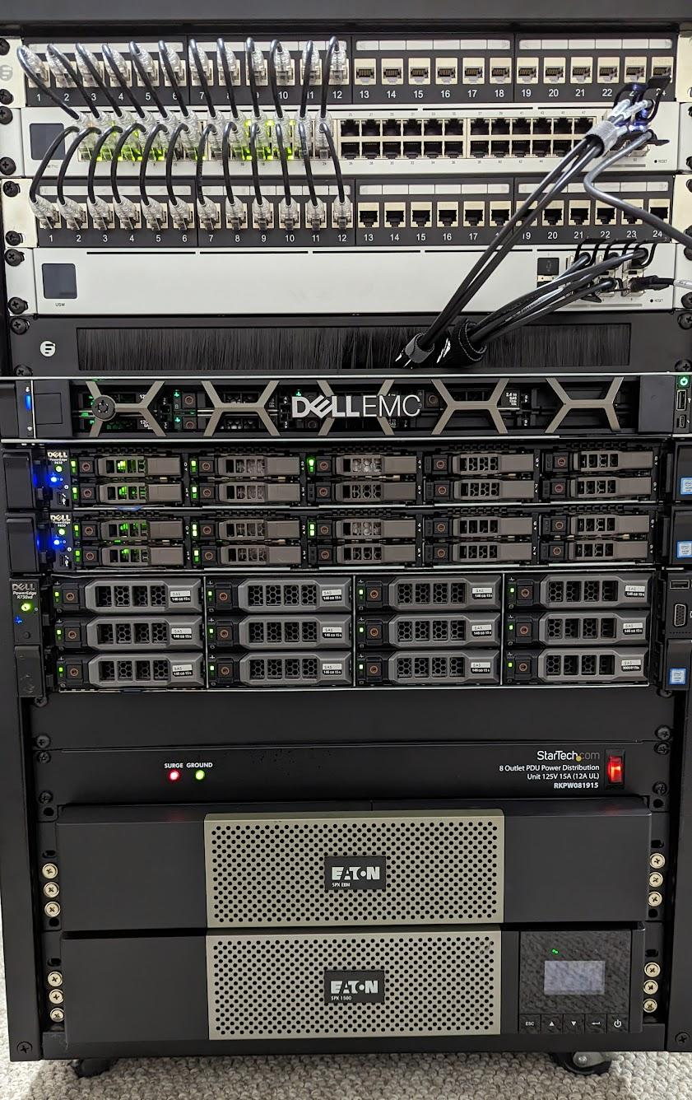
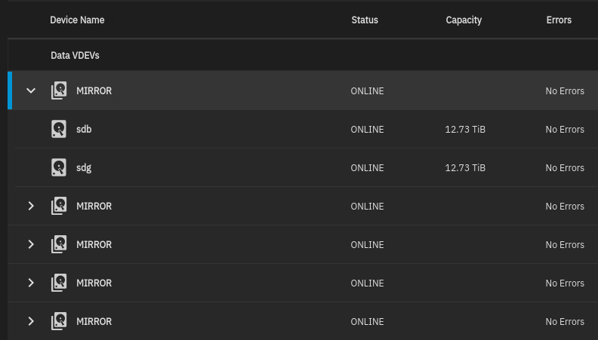
Homelab - TrueNAS SCALE Server
Dell R730XD 2U Server
TrueNAS SCALE 23.10 (Cobia)
2x Xeon E5-2660v3 CPU @ 2.60Ghz
256GB DDR4 ECC RAM
10x 14TB Western Digital 3.5” Disks (63TB)
2x 8TB Western Digital Purple (7.14TB)

Slide 17
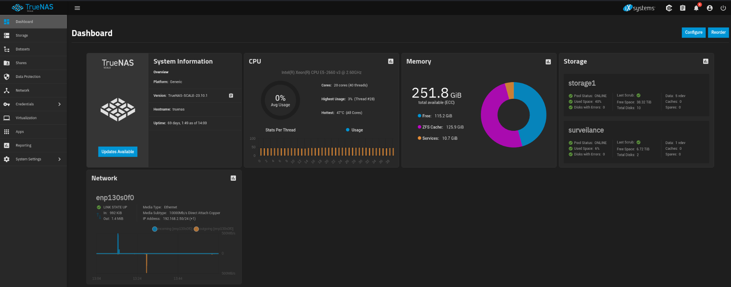
Web Dashboard
Notes:
Can click on individual resources, or go to Reporting to see more details on active usage.
ZFS will use up available RAM as much as needed. More RAM for read caching.
Can go through left side menus to create shares, adjust storage, manage users, and control virtual machines and apps.

Slide 18
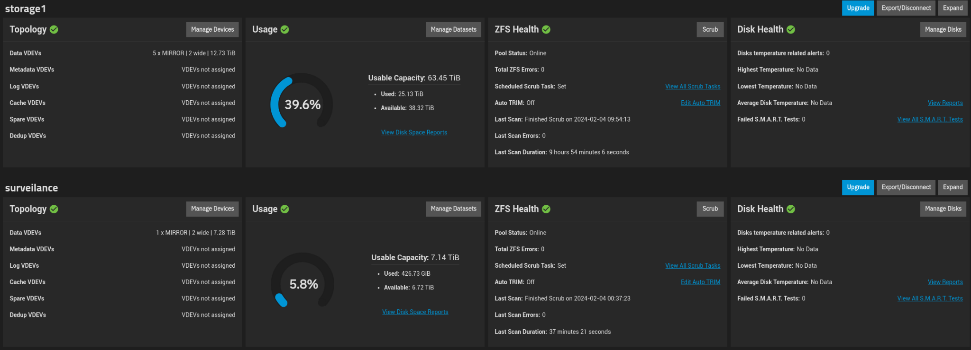
Storage Dashboard
Notes:
I have 2 pools created from all my drives. All the 14TB drives are mirrored and then striped (RAID-Z10)
The two Western Digital Purple drives are in a mirror for storing surveillance camera footage.

Slide 19
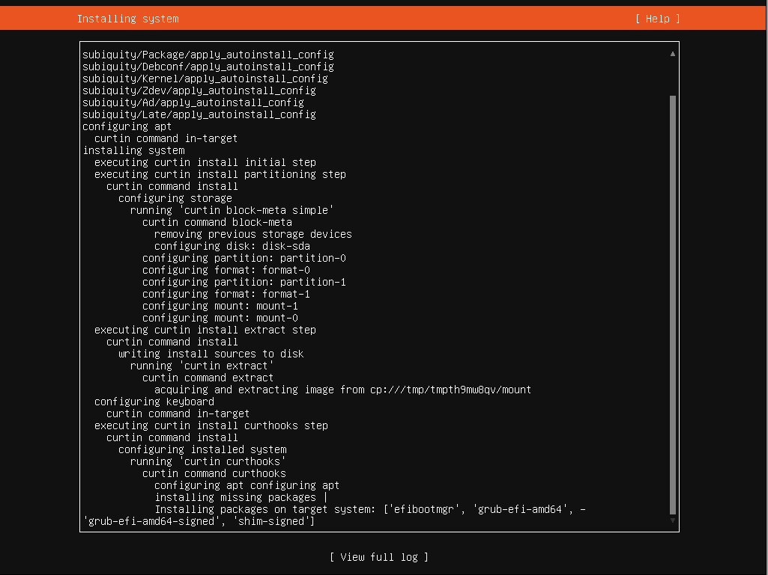
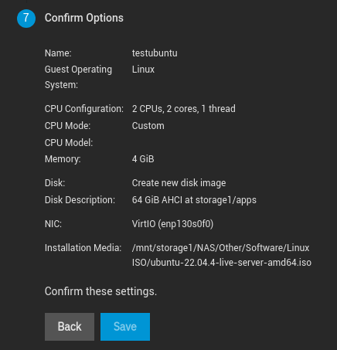
Virtualization
Notes:
Uses KVM (Kernel-based Virtual Machine).
Can use hardware NIC, or create a bridge to share interface and get access to shares.
Can customize hardware, including CPU, Memory, Disk, NIC, and GPU.
Web based display access using Spice Javascript Client.

Slide 20
Virtualization
Notes:
Options to add/remove devices to the VM, power on/off, copy, open a display or shell.

Slide 21
Applications
Notes:
Applications are run using k3s, a lightweight Kubernetes distribution.
Applications are deployed via Helm charts
When Applications are enabled, it creates an ix-applications dataset on your chosen pool to store all container related data.
Additional catalogs can be added, but at your own risk (i.e. TrueCharts)

Slide 22
Applications
Enterprise - iXsystems supported applications
Official - Tested for stability & curated by iXsystems
Community Apps - basic functionality tested
Third Party Catalogs
Notes:
Different tiers of applications. There are an Enterprise tier for paid users, which are directly supported by iXsystems.
The official tier have been tested more thoroughly.
The community apps have had some basic testing done.
Third party catalogs are available, there has been some drama there due to changes between versions. Use at your own risk.

Slide 23
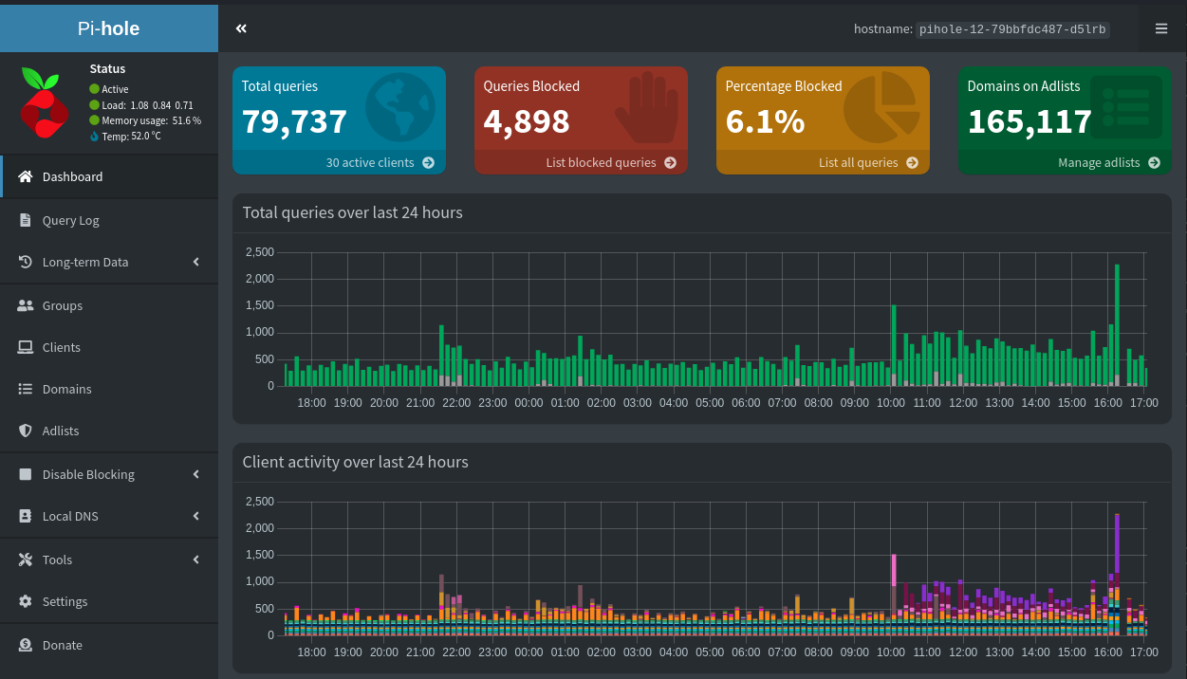
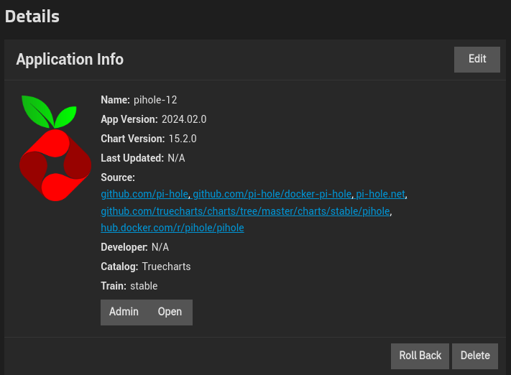
Applications - PiHole
Notes:
Main application I run on my TrueNAS server is Pihole.

Slide 24
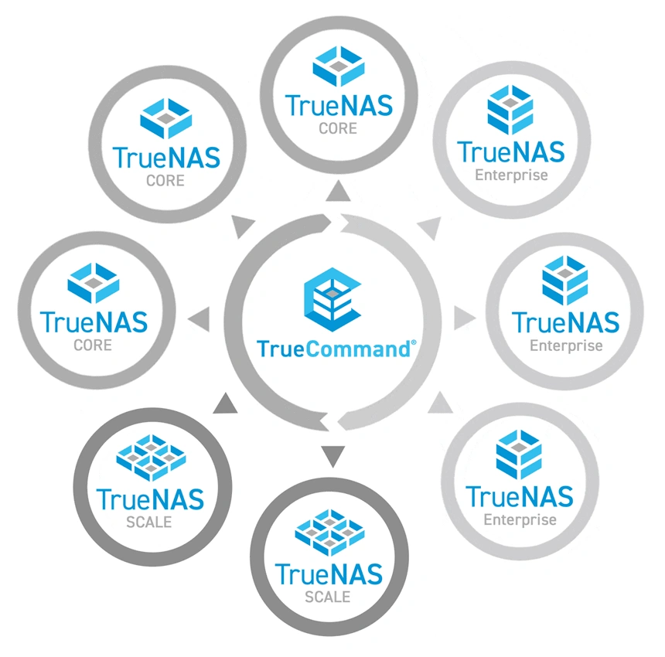
TrueCommand is a multi-system management application that helps control and monitor your TrueNAS fleet.
TrueCommand assists in managing TrueNAS systems through REST APIs, WebSocket APIs, and a web user interface.
The TrueCommand web interface provides single sign-on functionality and unified administration of users and TrueNAS systems.
Notes:
TrueCommand is a web based system for controlling and managing multiple TrueNAS systems.
I run most of my applications in a Proxmox clustered environment.

Slide 25
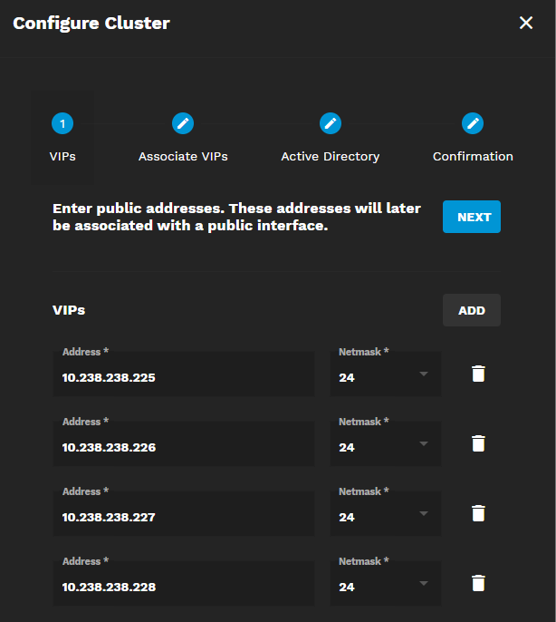
Clustering
TrueNAS SCALE SMB clustering using OpenZFS and Gluster scalable network file system.
Minimum 3 nodes, properly configured Active Directory environment.
Future of TrueNAS clustering uncertain…
Notes:
GlusterFS is an open-source software-based network-attached filesystem.
Can be deployed on top of ZFS to “scale out” to multiple file servers.
GlusterFS has been deprecated in Kubernetes 1.25 due to lack of maintenance.
TrueNAS SCALE 24.04 has removed the deprecated gluster backend.
TrueCommand 3.0 has not passed validation for Clustering.
The clustering feature is scheduled for removal in a future revision.
Future of clustering on TrueNAS SCALE is currently uncertain.

Slide 26
TrueNAS SCALE 24.04 - Dragonfish

Slide 27
TrueNAS SCALE vs Unraid
Feature | ixSystems - TrueNAS SCALE | Limetech - Unraid
License | Community Edition Free, iXSystems sells hardware and support services. | Unraid OS required one time license purchase. Pricing change announced February 19,2024.
Source Code | Open Source | Proprietary NAS OS based on Linux. Uses many open source resources.
File Systems | ZFS | XFS, BTRFS, ZFS in progress.
Virtualization | KVM | Previously Xen, now KVM
Containers | Docker via k3s | Docker Manager
Community | Higher Learning Curve | Active and friendly support
Notes:
BTRFS limitations - write hole for RAID. RAID5/6 not recommended.
Unraid storage limitation - max 30 drives total (28 data, 2 parity)
Able to use disks of different sizes, extend and resize array.

Slide 28
Resources
BackBlaze Article - Hard Drive Cost Per GB
IXsystems - TrueNAS SCALE
ItsFoss Article - What is ZFS
45Drives - How ZFS Organizes Its Data
45Drives - ZFS Caching
45Drives - ZFS Best Practices

Slide 29
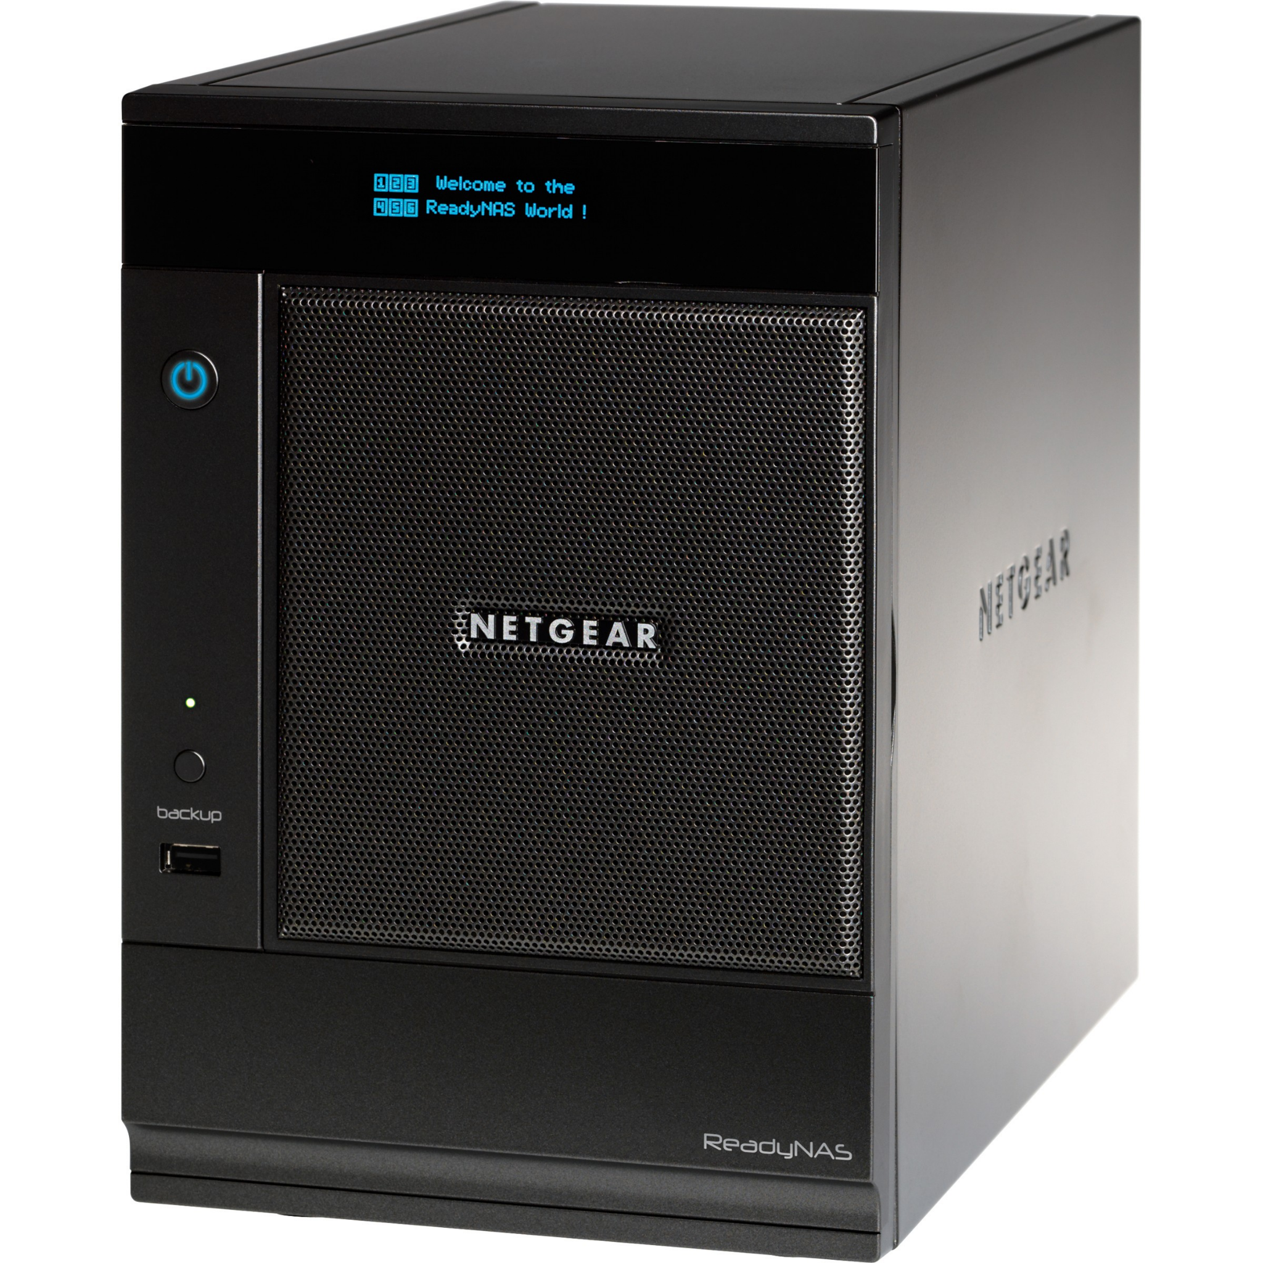
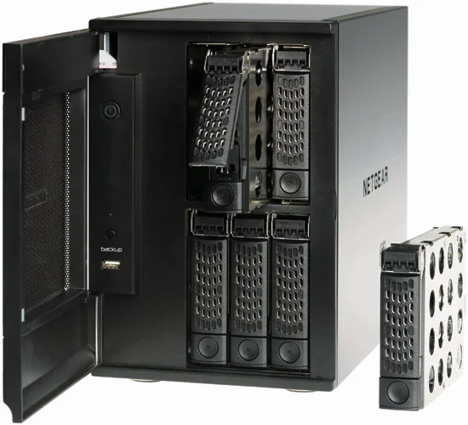
Contest - Netgear ReadyNAS Pro 6
Notes:
Netgear ReadyNAS Pro 6 Business - 6 Bay NAS - Purchased in 2010
RNDP6000-100NAS
Added laptop ram, full dual-core Intel CPU, dual 1Gbps NIC.
Possible to upgrade BIOS and install TrueNAS SCALE by adding a VGA header

Slide 30
Questions

Slide 31
Survey
Survey Link: https://forms.gle/Ze1eLZC7LFSgHnqH6

