Slide 1
A Conversational Family Recipe Assistant
Darryl Ruggles
DEV201
Darryl Ruggles
Cloud Solutions Architect
Ciena

Slide 2
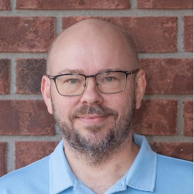



About Me
Darryl Ruggles
Principal Cloud Solutions Architect @ Ciena | AWS Hero
25+ years in software and cloud - C/C++ embedded, Java, ReactJS, microservices, containers, serverless, traditional AI/ML and MLOps, observability, DevOps, SRE, FinOps, and now GenAI.
Passionate about event-driven architecture, observability, and building things with serverless and managed AWS services. Continuous learner who enjoys sharing what I find along the way.
Current focus: agentic AI development across multiple vendors and models, and right-sizing cloud environments through FinOps practices.
LinkedIn linkedin.com/in/darryl-ruggles
Website darryl-ruggles.cloud
GitHub github.com/RDarrylR
LinkedIn
Website

Slide 3
A lifelong love of cooking
Inherited from my mother - cooking and recipe collecting are family traditions.
My wife and I grew up in small communities in Nova Scotia.
Decades of recipes from family, neighbours, church cookbooks, magazine clippings.
Always wanted a real searchable index. Always felt overwhelmed by the data entry.

Slide 4
Phase zero: print, scan, dump in Dropbox
A few years ago I gave up on perfect and just printed and scanned everything.
Loaded the PDFs into Dropbox.
Dropbox's filename search was "good enough" - we found recipes most times.
Useful, but not a system. Not searchable by ingredient or nutrition.

Slide 5
The keto pivot - now nutrition matters
Switched to a strict keto diet, started exercising regularly.
Hundreds of new keto recipes + keto-friendly remixes of family favourites.
Collection grew past 600 recipes.
On keto, you live and die by the macros: fat, protein, fibre, calories - and carbs.

Slide 6
Why now? RAG finally became approachable
Background: a few years on an MLOps team with classical ML and early LLMs.
RAG (Retrieval Augmented Generation) fits: ground the LLM in my own recipes.
Bedrock Knowledge Bases handle chunking, embeddings, vector store, retrieval.
S3 Vectors makes the storage piece almost free at hobby scale.

Slide 7
What I wanted to build
Search 600+ family and keto recipes by ingredient, technique, or feel.
Real nutrition for every recipe, even the ones that never had it.
Conversational - follow-up questions, scaling, substitutions.
Hands-free in the kitchen - voice in, voice out, with interruptions.
Cheap enough to leave running - serverless, scale-to-zero where possible.

Slide 8
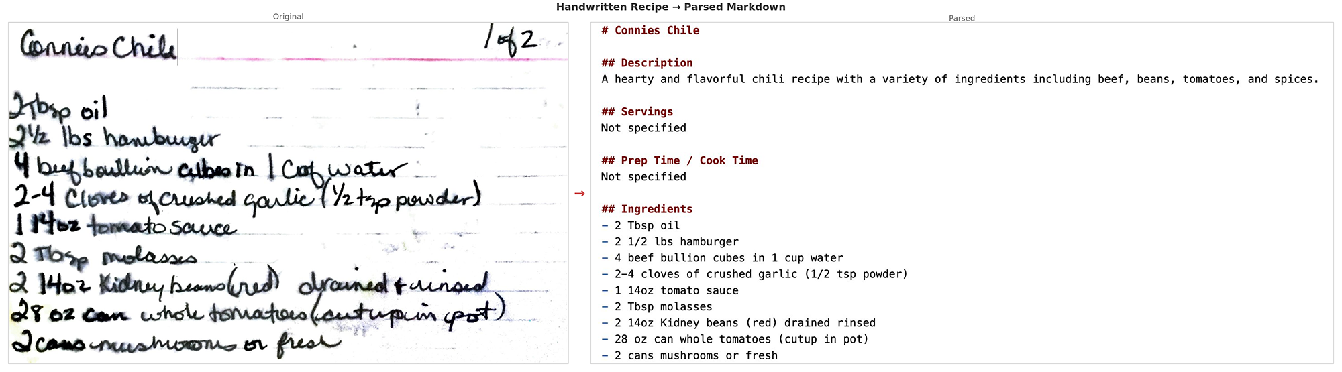
Ingestion: Nova Pro reads the recipe pile
~600 PDFs, scans, phone photos, handwritten cards, clippings.
Amazon Nova Pro (multimodal) extracts each one to clean Markdown.
~90% land clean; the rest - stained or sloppy handwriting - are a quick edit.

Slide 9
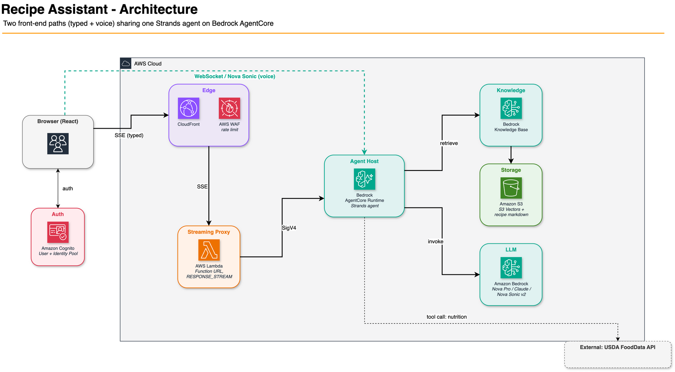
Combined architecture

Slide 10
Enrichment: real macros via USDA
Older recipes have no nutrition info. Most need it added.
USDA FoodData Central API - free, comprehensive, well-maintained.
Per ingredient: parse qty + unit, look up per-100g values, scale to recipe.
Cache responses. Tag values [USDA] vs [estimated] so I know what's real.

Slide 11
Bedrock Knowledge Base + S3 Vectors
Point a Knowledge Base at the S3 bucket of markdown files. Done.
Semantic chunking preserves recipe structure.
Titan Embed V2 (1024-dim) embeddings stored in S3 Vectors.
S3 Vectors: zero idle cost, ~$0.00004 per query.
Chunk merging on retrieval - one recipe, not three fragments.

Slide 12
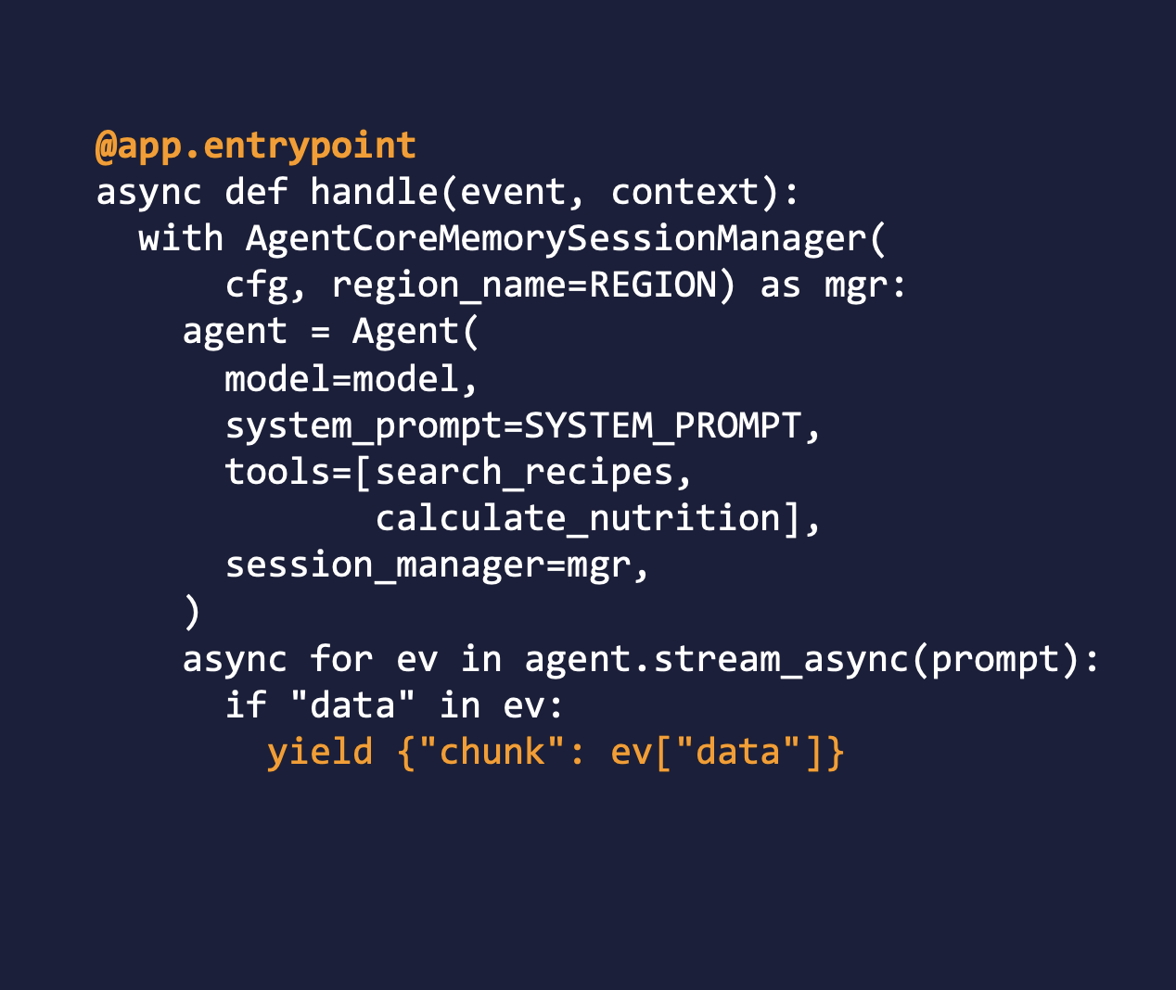
Strands and AgentCore: Clean & Simple
Strands SDK - thin Python. Tools are @decorated functions.
Two tools: search recipes and calculate_nutrition.
AgentCore Memory: multi-turn context per session.
AgentCore Runtime hosts the agent. Scales to zero, IAM auth, SSE.
Deploy with the AgentCore CLI.

Slide 13
Streaming the typed chat back to the browser
CloudFront + Lambda Function URL (RESPONSE_STREAM mode).
Lambda signs SigV4 to AgentCore, relays SSE chunks to the browser.
Need a long-lived streaming response - not a 29-second request/response.
Tool-use events shown in UI: "Searching recipes...", "Calculating nutrition...".
Aborts rotate the session ID - a stopped turn won't poison memory.

Slide 14
Phase 1 worked - but the kitchen has hands
Typed chat works. Polly TTS reads recipe steps aloud ("cooking mode").
But Polly is one-shot - can't interrupt mid-step or ask a question.
Typing while cooking is awful - hands are full, dirty, or both.
I want a real conversation, not a smarter search box.

Slide 15
Phase 2: Nova Sonic + Strands BidiAgent
Amazon Nova Sonic v2 - speech in + out in one model. No separate STT/TTS.
Strands BidiAgent + BidiNovaSonicModel - bidirectional WebSocket session.
Same agent, same tools, same KB - plus cooking_timer + unit_converter.
BidiAgent collapses ~150 lines of WebSocket plumbing into ~20 lines.
Just a web page - works on laptop, iPad, and phone with no install.

Slide 16
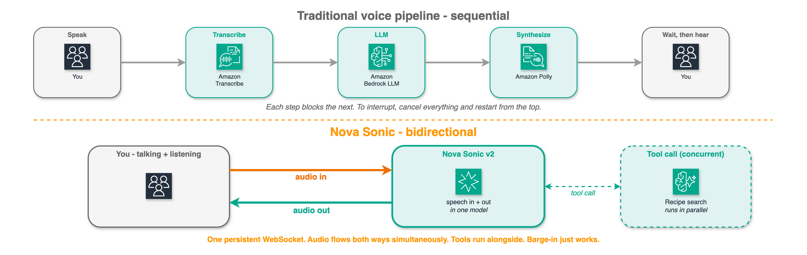
Why "bidirectional" actually matters

Slide 17
Voice - things to watch out for
Audio pacing: Nova bursts audio after a tool call. 5-second buffer overflows; 60 sec is safe.
Model ID typos: connection succeeds, audio silently ignored. Use amazon.nova-2-sonic-v1:0.
Voice IDs are case-sensitive. "Tiffany" fails silently; "tiffany" works.
WebSocket auth: SigV4-presigned WSS URL via Cognito Identity Pool credentials.
Scoping InvokeAgentRuntimeWithWebSocketStream to a runtime ARN breaks. Use *.
Sessions cap at 8 minutes. Bidirectional invokes are not logged to CloudWatch.

Slide 18
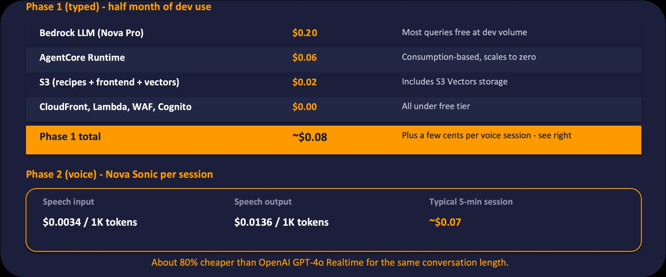
It really does cost ~$0 at hobby scale

Slide 19
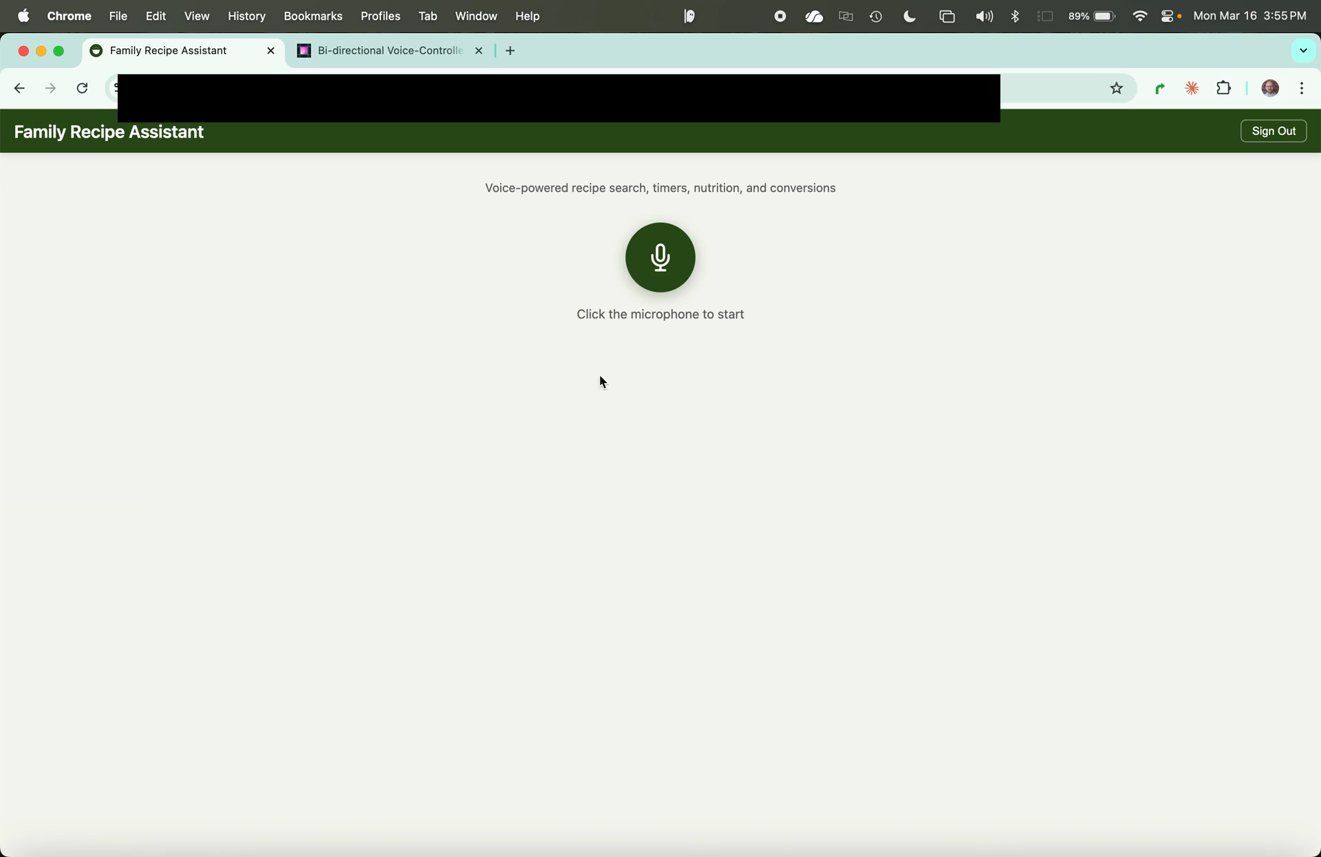
Demo of Recipe Assistant

Slide 20
What's next - and thank you
Merge typed + voice on AgentCore WebRTC - one transport for both.
Session rotation past Nova Sonic's 8-minute cap, with context preservation.
Shopping lists with prices - Loblaws, Walmart, Costco.ca.
iPad-first UI for the kitchen counter; eventually Alexa.
Blog 1: darryl-ruggles.cloud/serverless-recipe-assistant-with-agentcore-and-strands/
Blog 2: darryl-ruggles.cloud/bi-directional-voice-controlled-recipe-assistant-with-nova-sonic-2/
GitHub: github.com/RDarrylR/serverless-family-recipe-assistant

Slide 21

Thank You

