Slide 1

TORONTO | JUNE 03, 2026

Slide 2

Building a Personal AI Assistant in minutes with OpenClaw on AWS
Ajay Dhungel

Slide 3
What is OpenClaw?
Explore our products
Always running AI
Easier access
Autonomous
connects to your messaging apps
acts on your behalf when you're not at your desk.
A self-hosted AI agent that runs 24/7

Slide 4
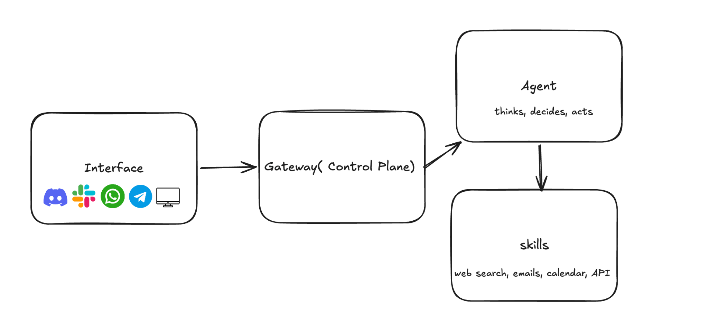
The Architecture

Slide 5
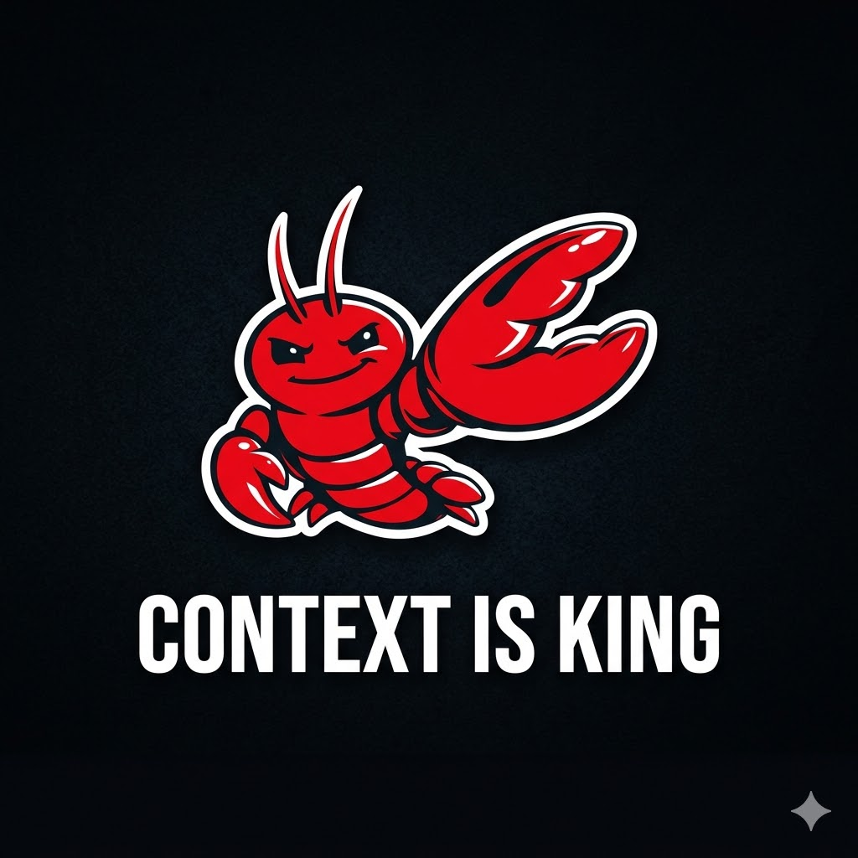
What makes OpenClaw good
Always on
Smart Context
Persistent Memory
Agentic Orchestration
Injection-Safe
Model Agnostic

Slide 6
Breaking the internet
HOW WE MAKE THIS HAPPEN
Nov 2025: Clawdbot ships as a side project
Dec 2025: Goes viral . 180K retweets in 48 hours.
Jan 2026: Anthropic trademark notice. Three days later: OpenClaw.
with over 370,000 Stars on Github, OpenClaw is the Fastest growing OSS project ever.

Slide 7

Amazon Lightsail
Managed cloud servers. Fixed price. No surprises.
Launch in minutes, pick a blueprint and go
From $10/mo, no unexpected AWS bills
Firewall, DNS and networking handled for you
Amazon Lightsail

Slide 8


Cost Comparison\
Amazon Lightsail
Mac Mini
Upfront
0
$600+
Monthly
$10+
0
Setup
Minutes
Hours
Maintenance
Managed
Self-managed
Scaling
Easy
Difficult

Slide 9
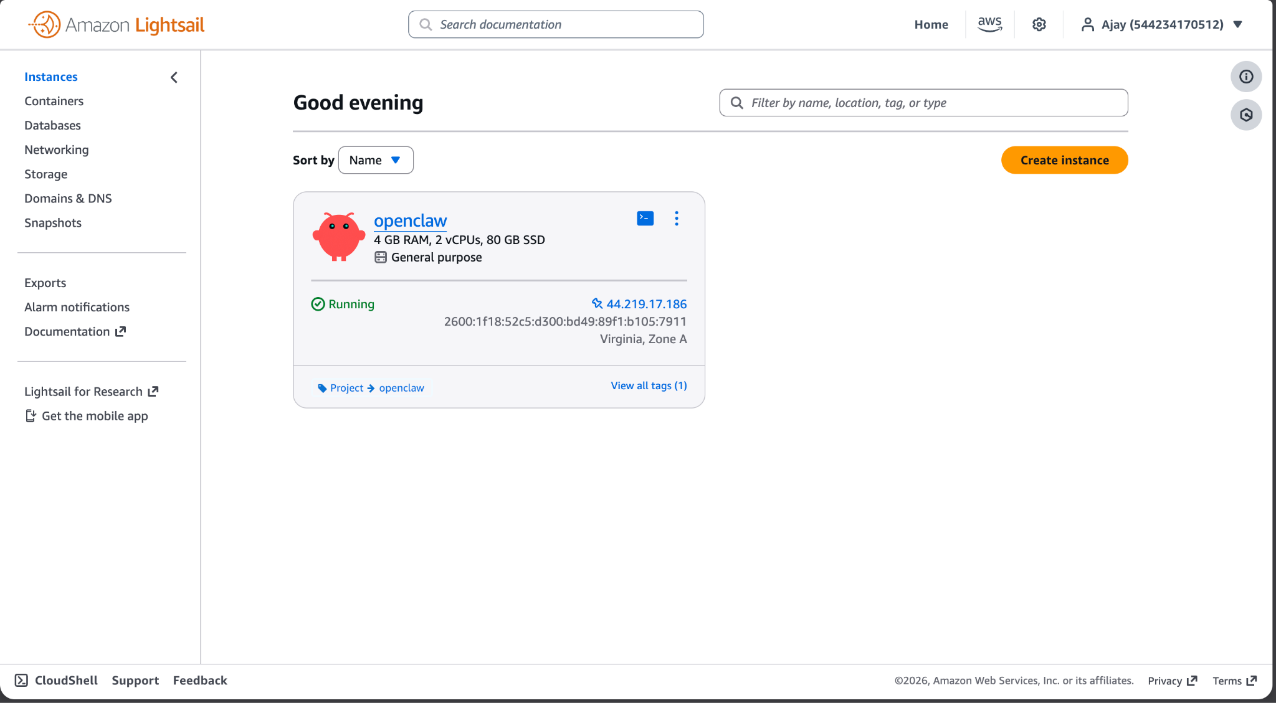
Hands-on Lightsail

Slide 10
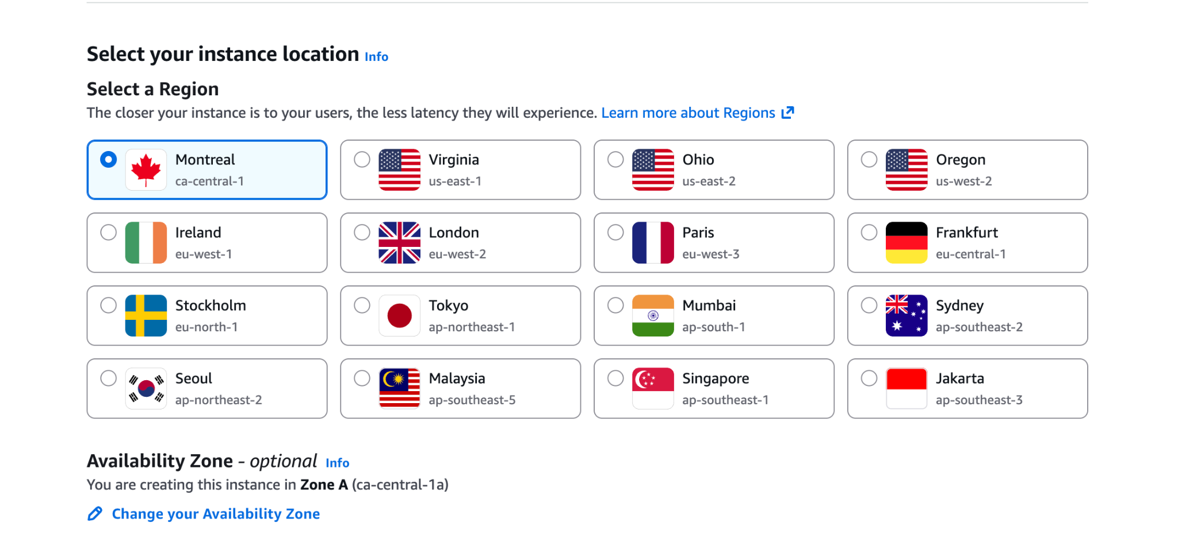
Choosing the region and AZ

Slide 11
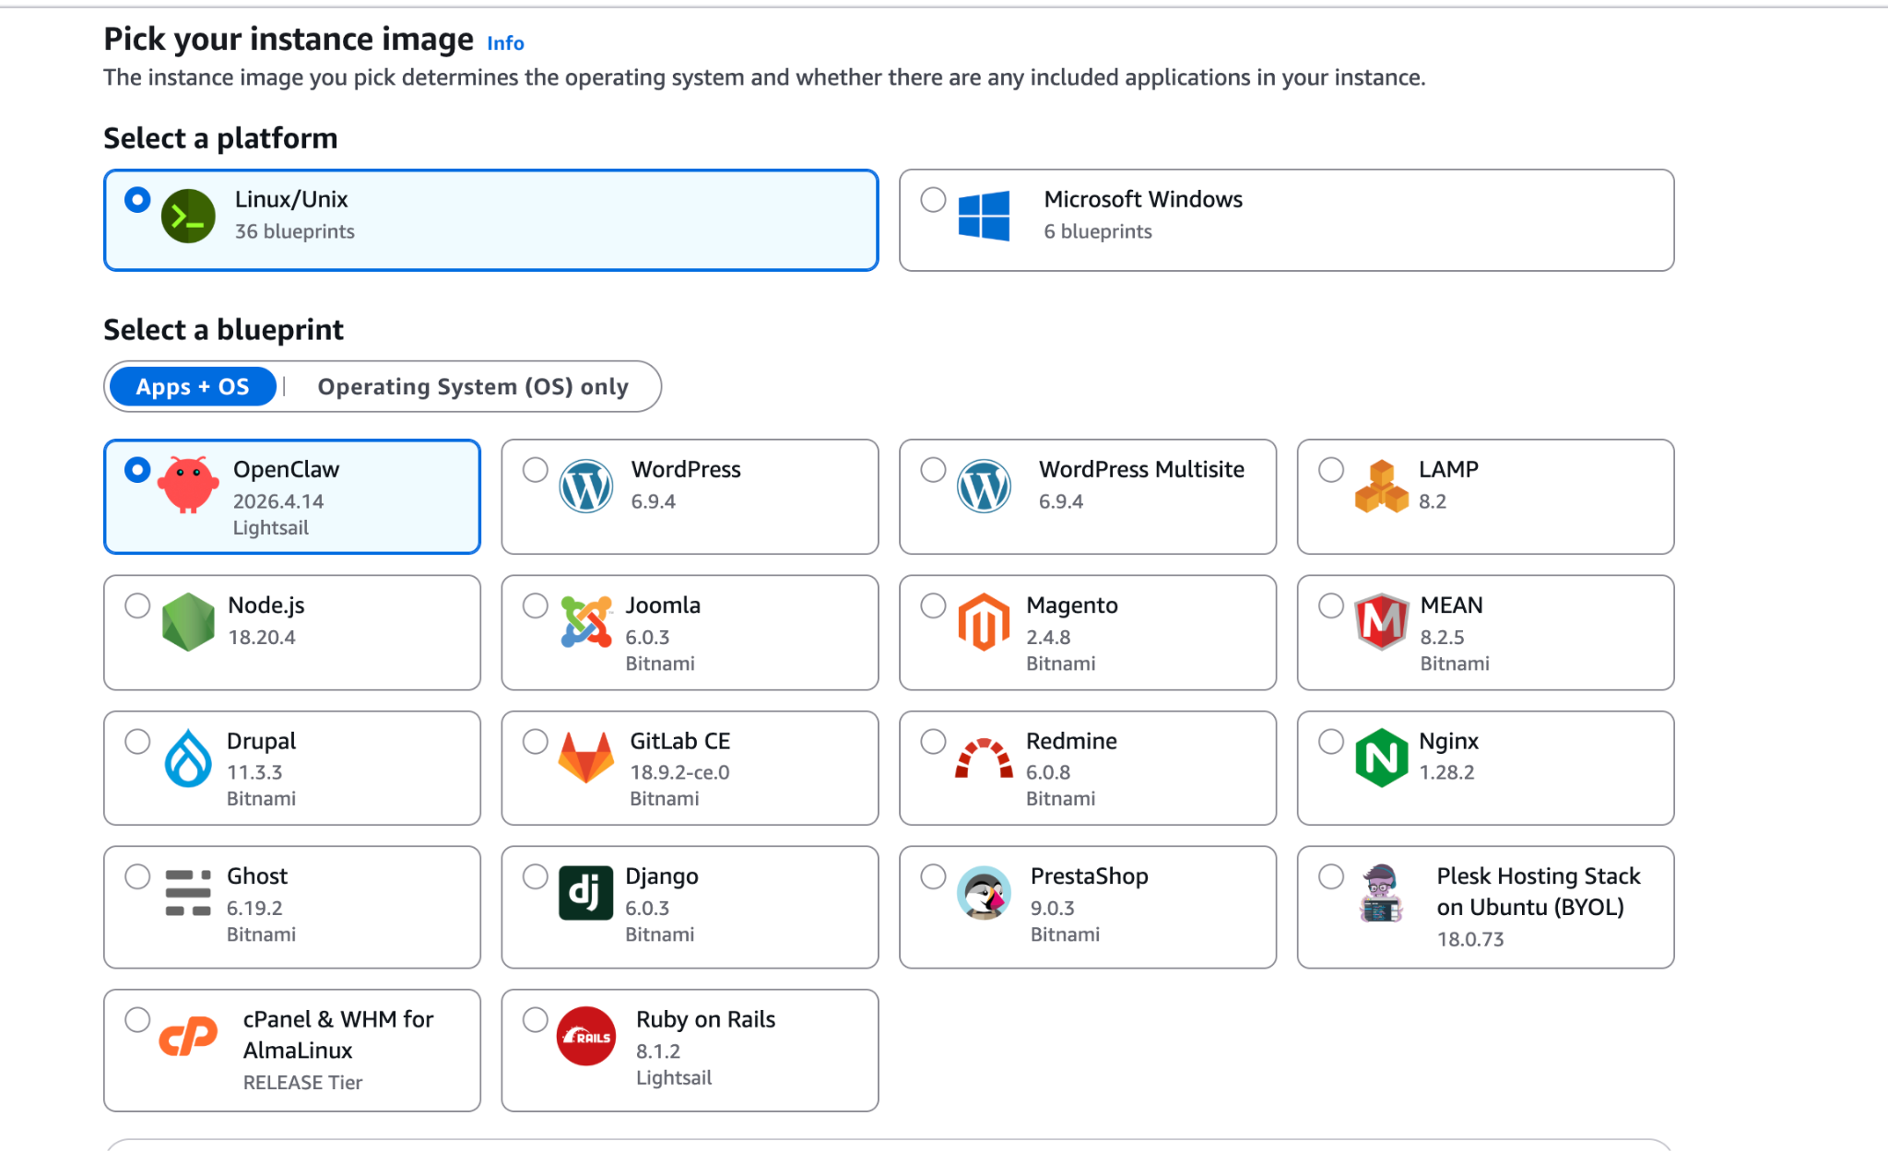
Selecting the Image and blueprint

Slide 12
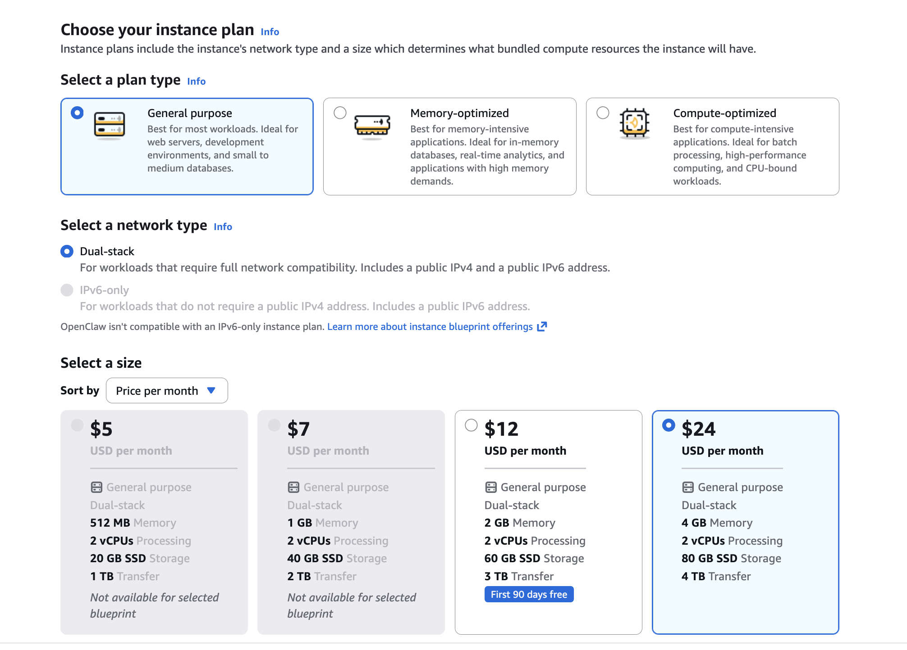
Choosing the instance type and size

Slide 13
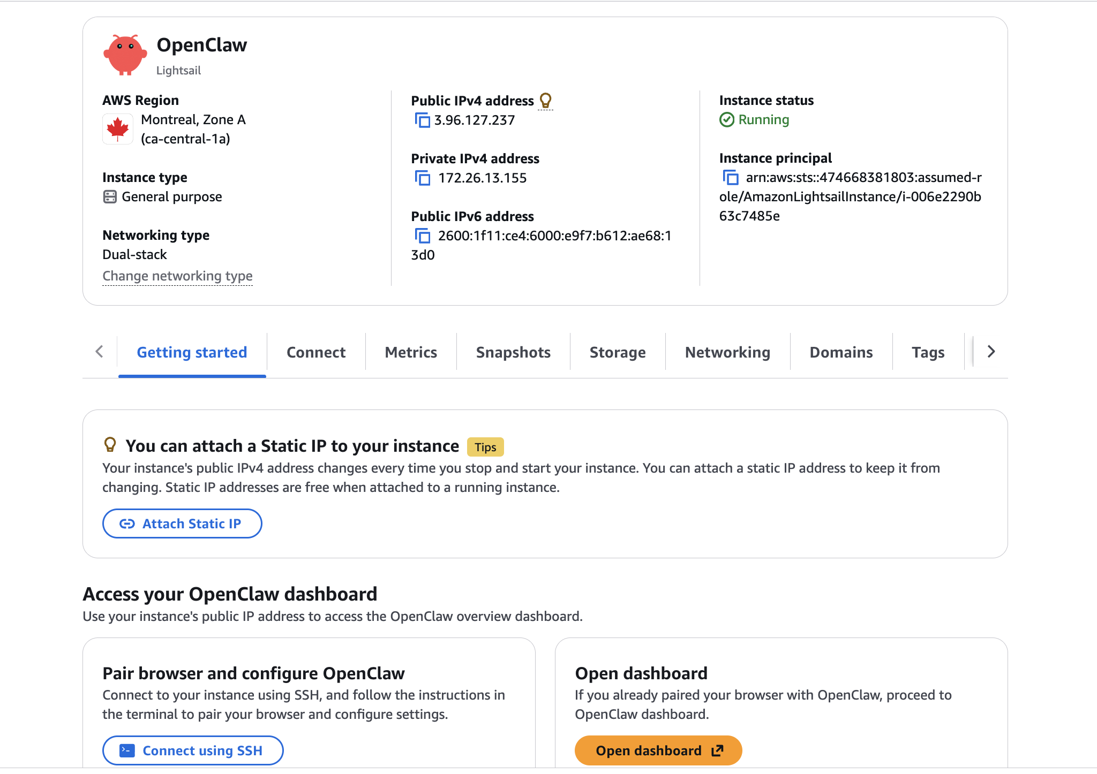
Instance up and running

Slide 14
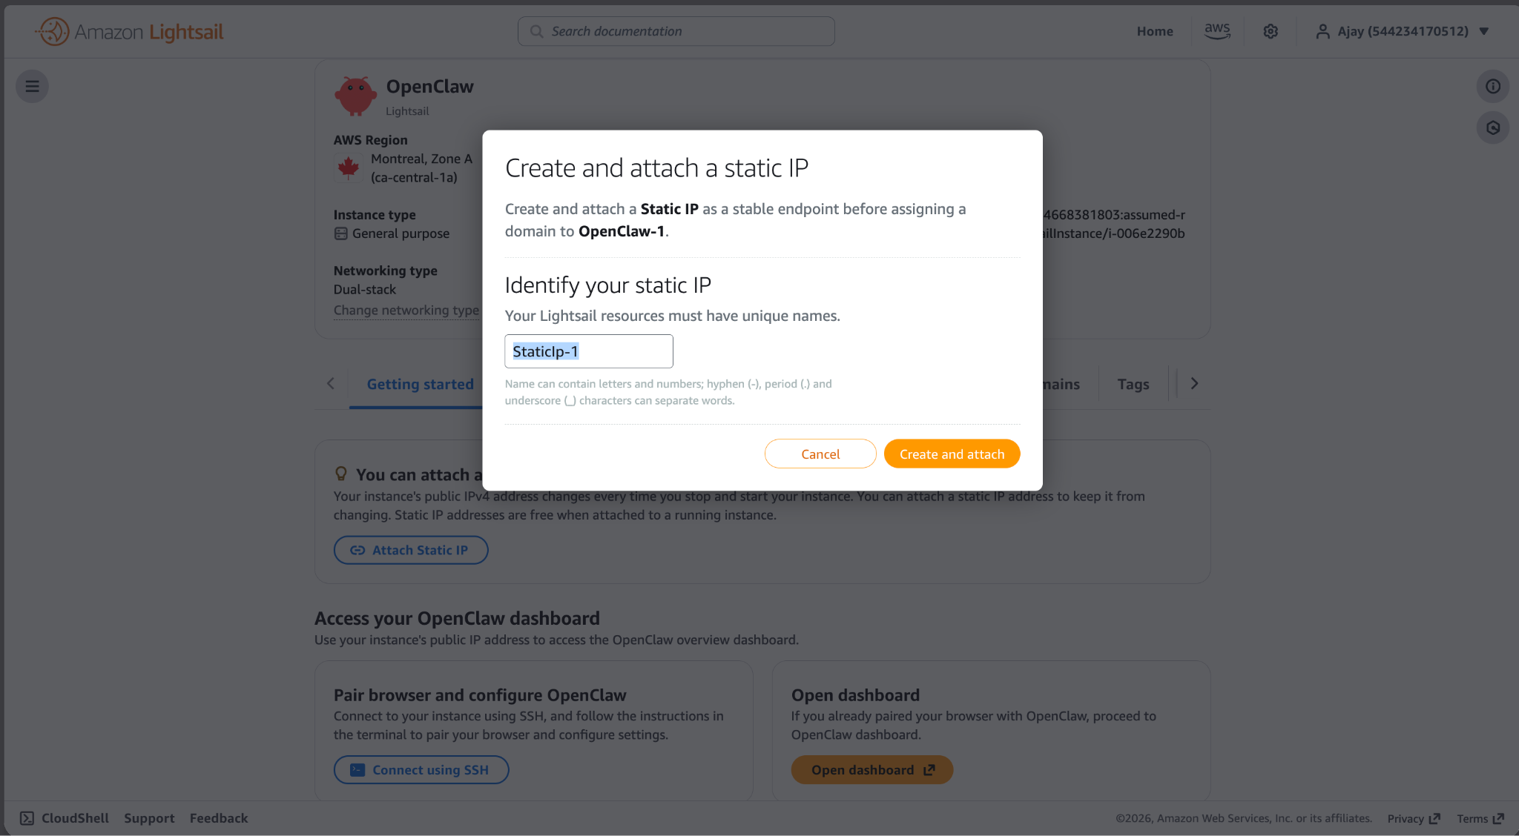
Create and Attach a static IP

Slide 15
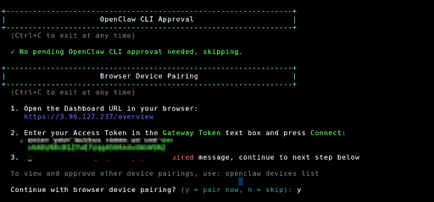
ssh to get the token

Slide 16
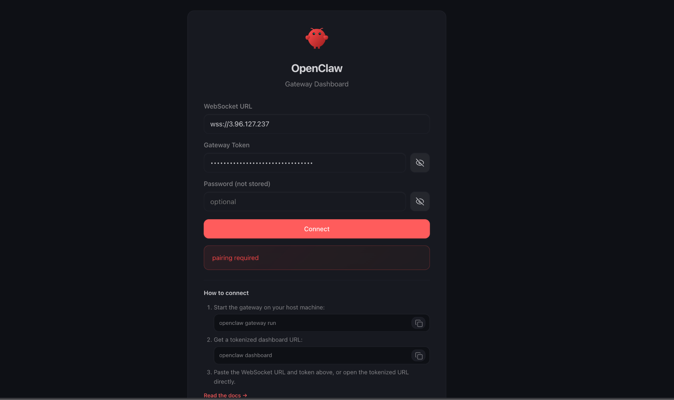
Enter the token to send the pairing request

Slide 17
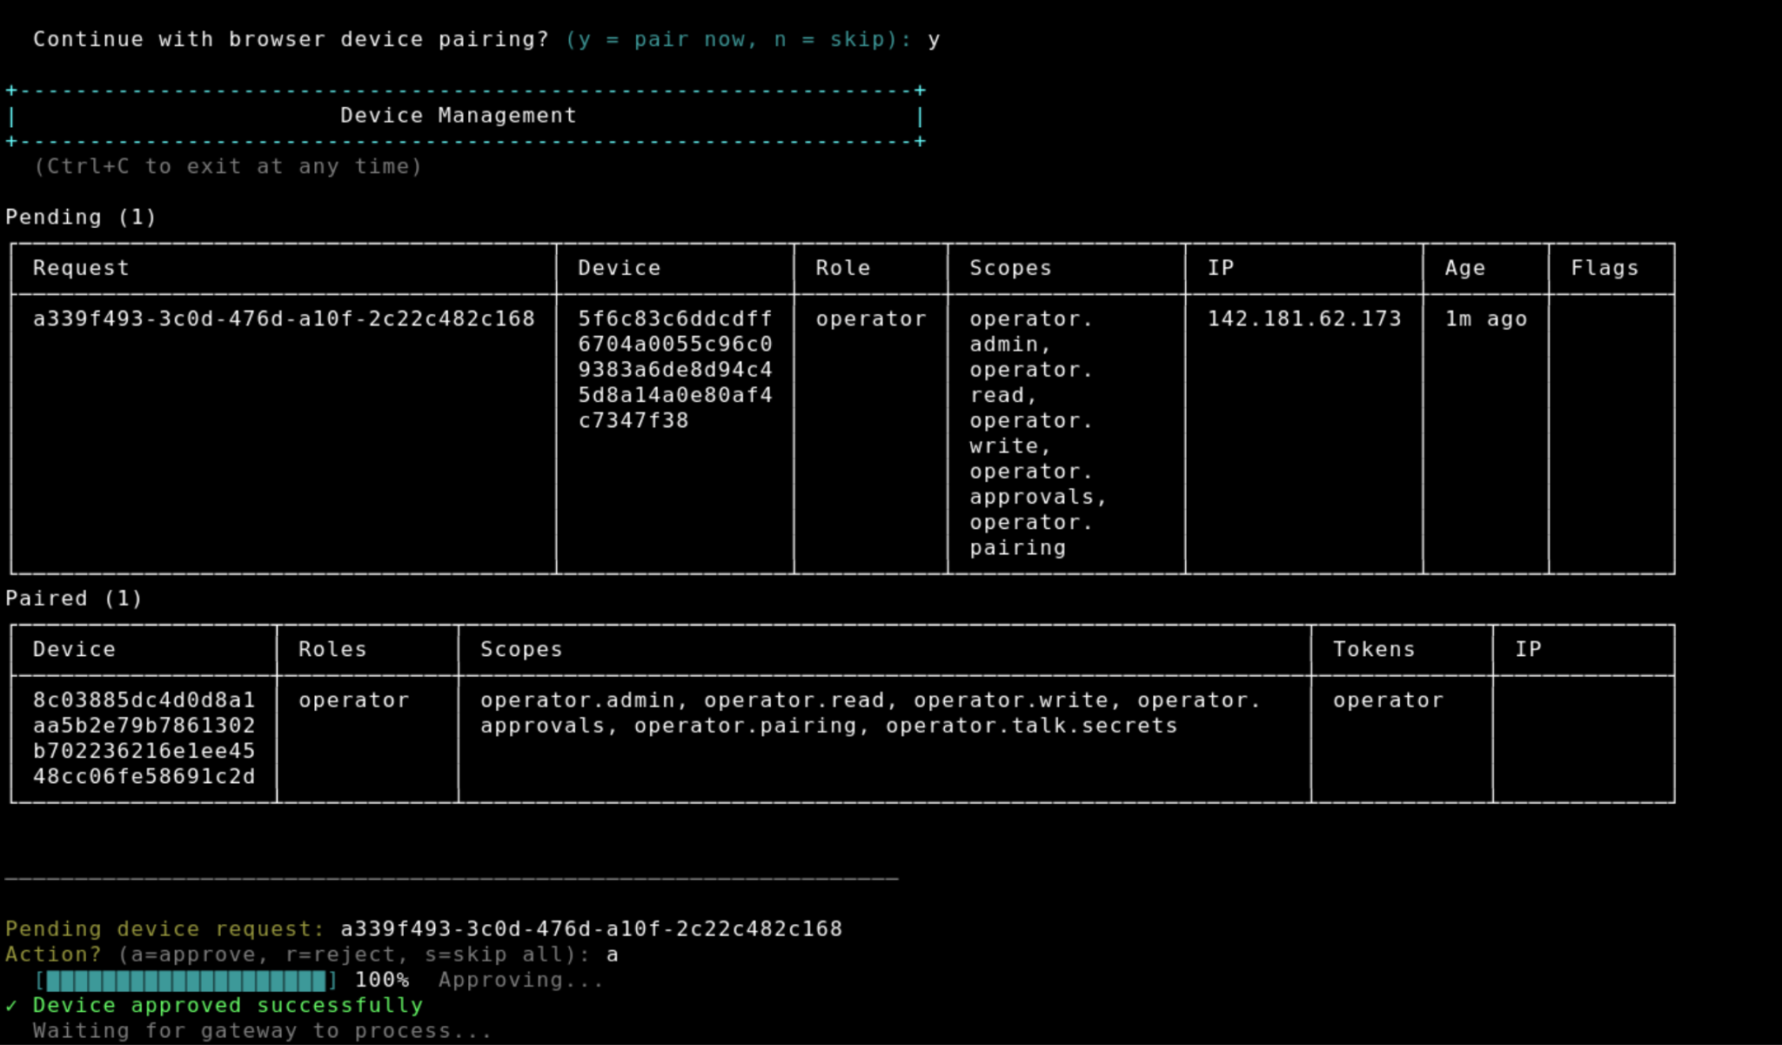
continue in the interactive cli to approve

Slide 18
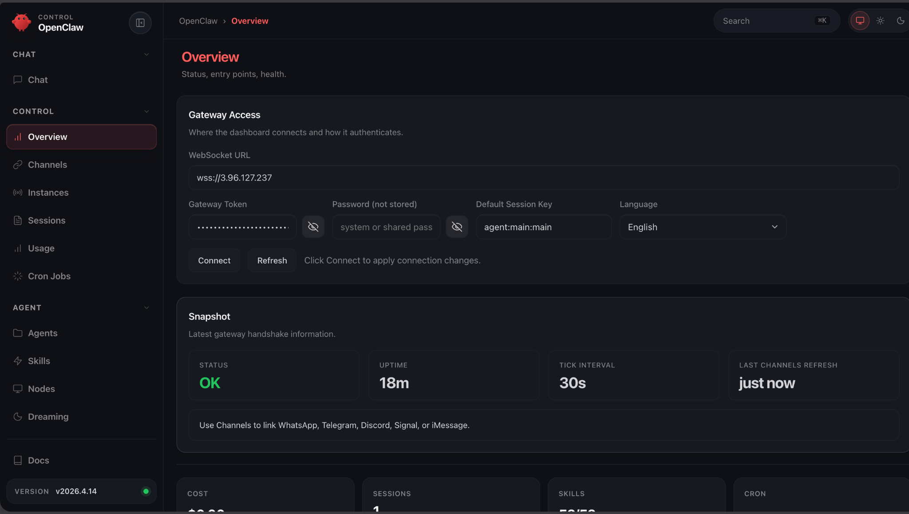
Enter the url and login again to access

Slide 19
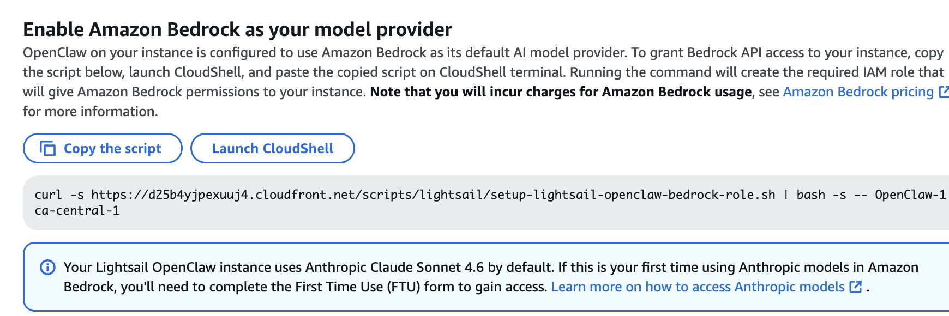
Copy the script to create the bedrock role

Slide 20
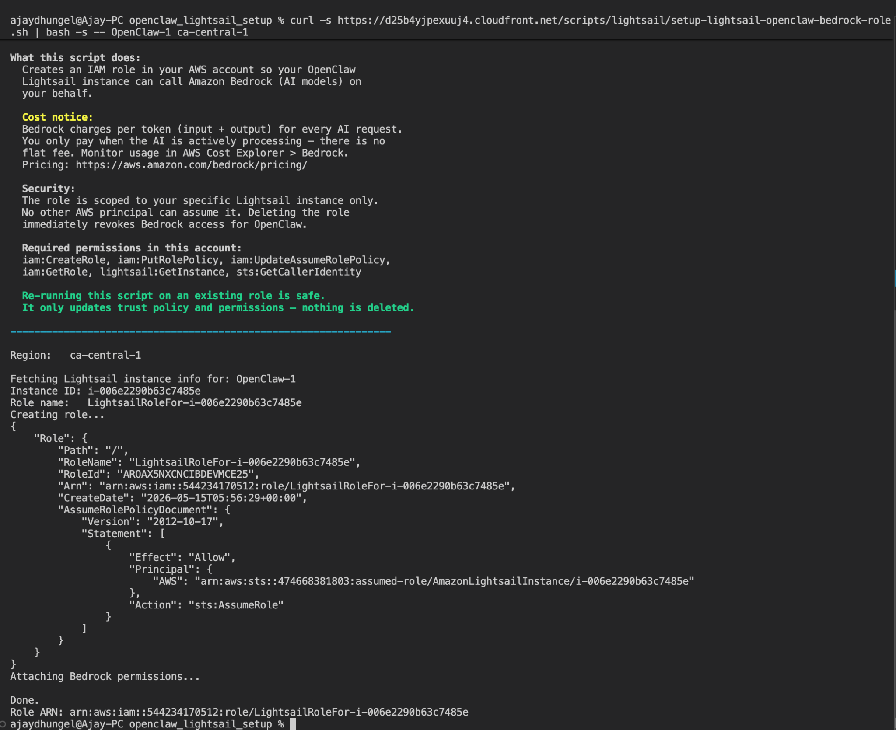
Running the script to allow Bedrock permission

Slide 21
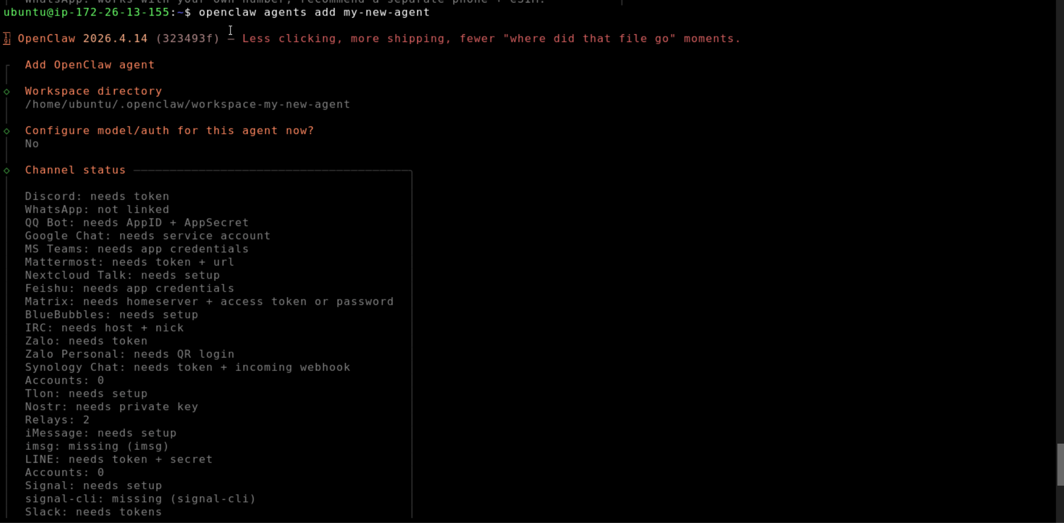
Create your first agent

Slide 22
Automating it all
Prerequisites
AWS account
AWS CLI configured
Terraform
Ansible
Telegram bot token from BotFather
Google OAuth credentials
Notion API key

Slide 23
Resources and Automation
Explore our products
Create
Configure
Orchestrate
Terraform
provisions the Lightsail instance, static IP, firewall rules, and Bedrock IAM role
Ansible
configures OpenClaw on the server, agents, MCP servers, Telegram, cron jobs
Makefile
The single entry point, wraps everything into simple commands like make configure

Slide 24
Terraform
HOW WE MAKE THIS HAPPEN
Lightsail instance
Static IP, attached to the instance
Firewall rules
Bedrock IAM role
Automate creation of these
resource

Slide 25
Ansible
HOW WE MAKE THIS HAPPEN
Install and starts the OpenClaw gateway
Deploys the orchestrator agent with its soul and prompt
Connects MCP servers, Gmail, Calendar, Notion
Sets the Telegram bot token
Schedules the morning briefing cron job with the correct timezone
Automatically perform the following steps

Slide 26
Why
Makefile
HOW WE MAKE THIS HAPPEN
make apply → runs Terraform
make configure → runs Ansible
make destroy → tears everything down
One command. No flags. No syntax to remember.

Slide 27
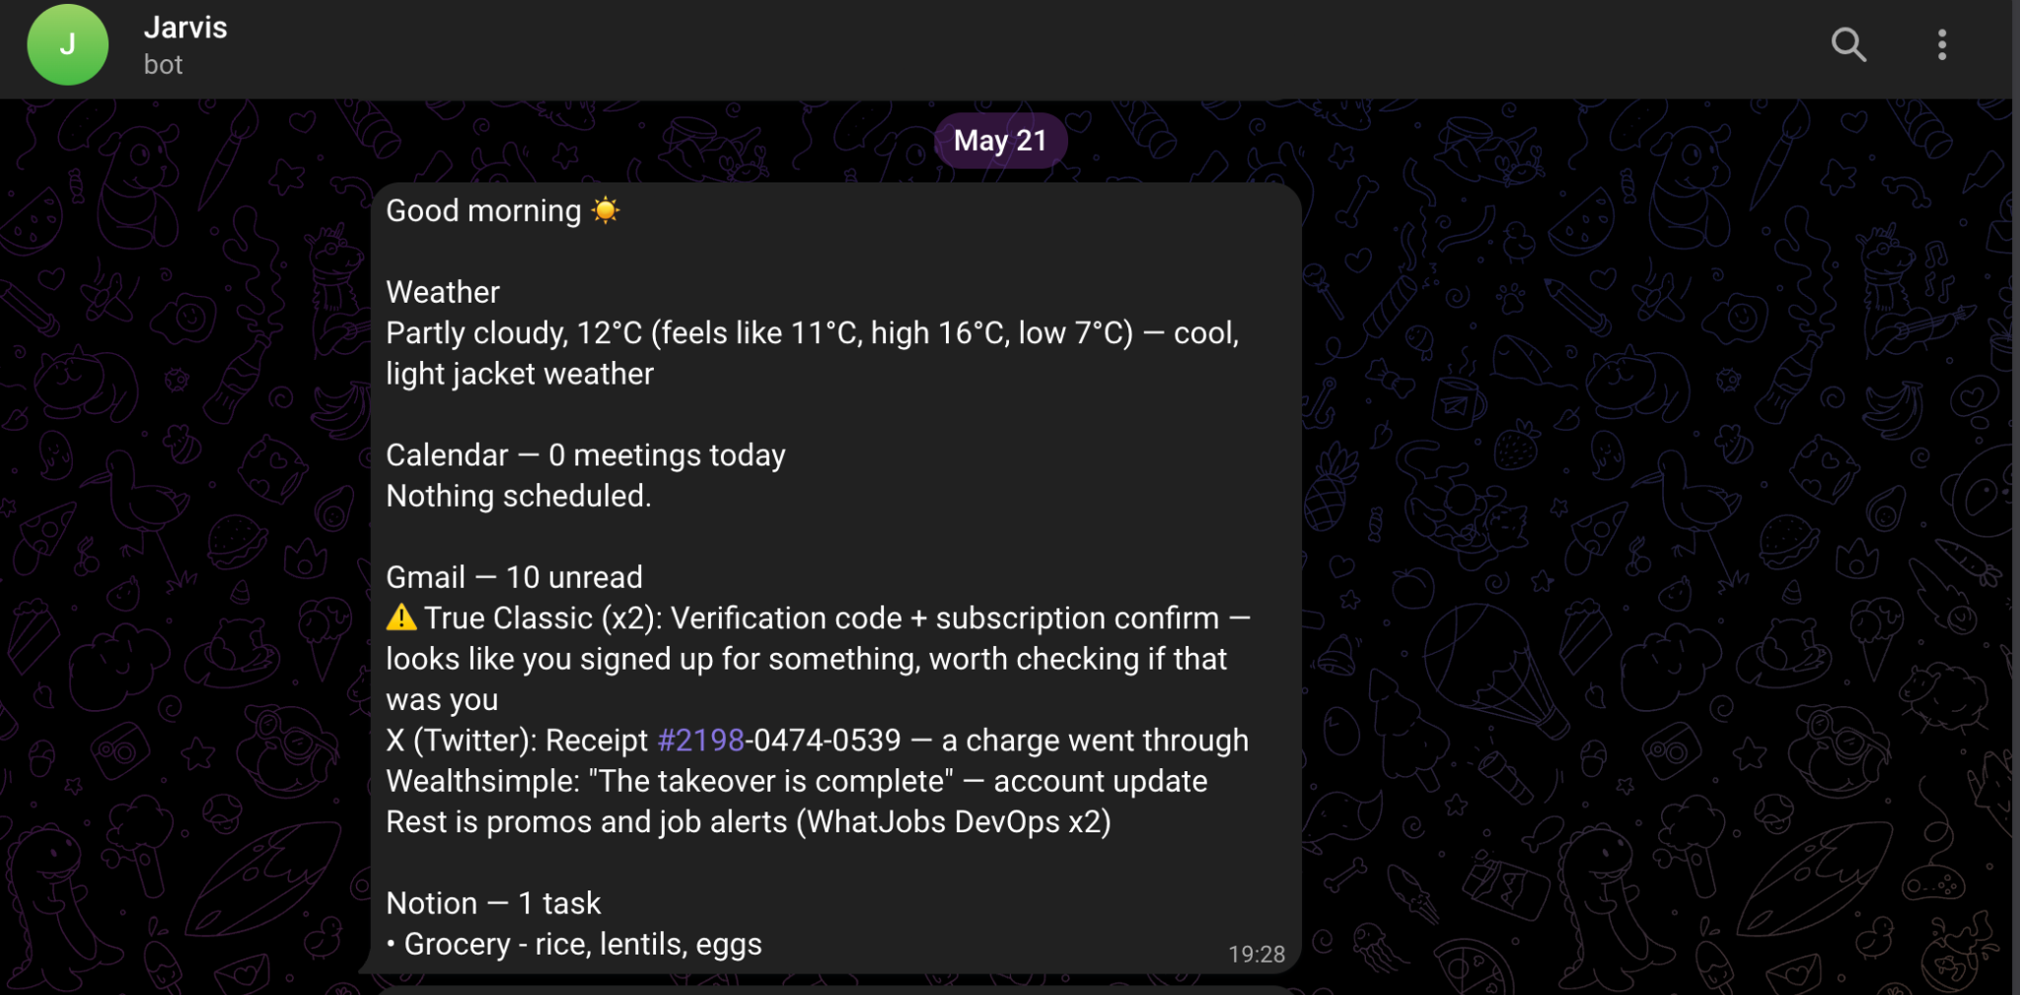
Openclaw in action

Slide 28
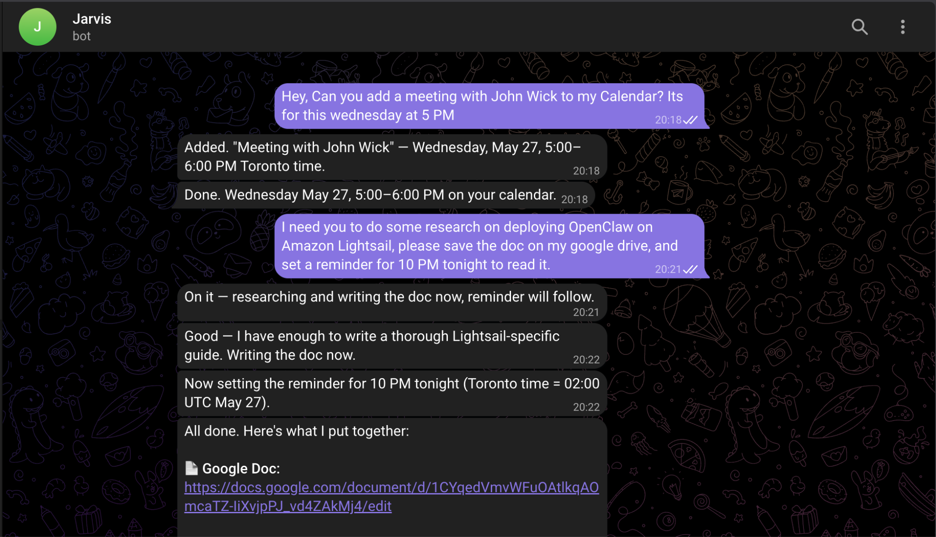
Openclaw in action

Slide 29
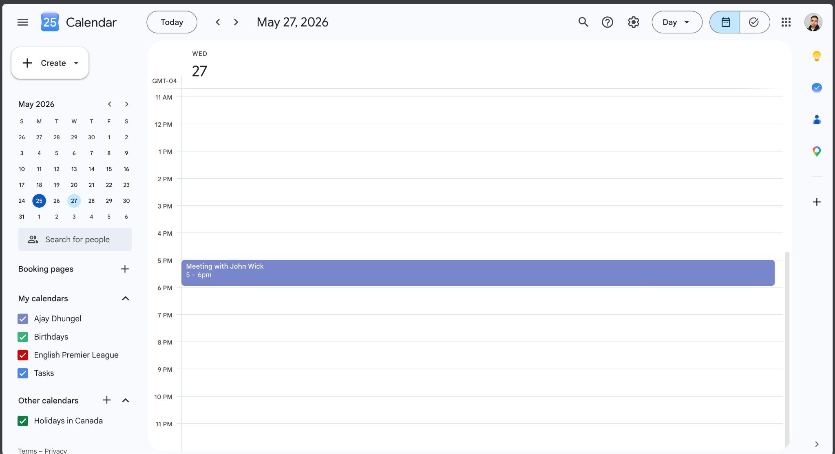
Openclaw in action

Slide 30
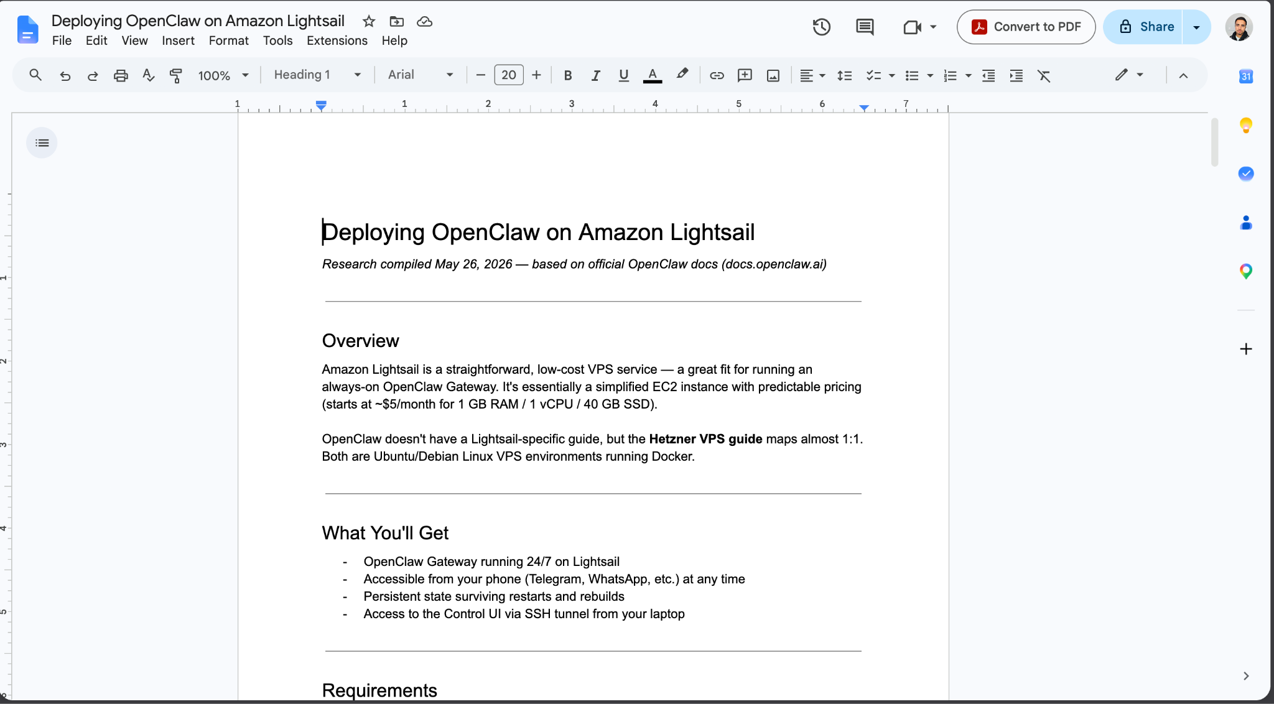
Openclaw in action

Slide 31
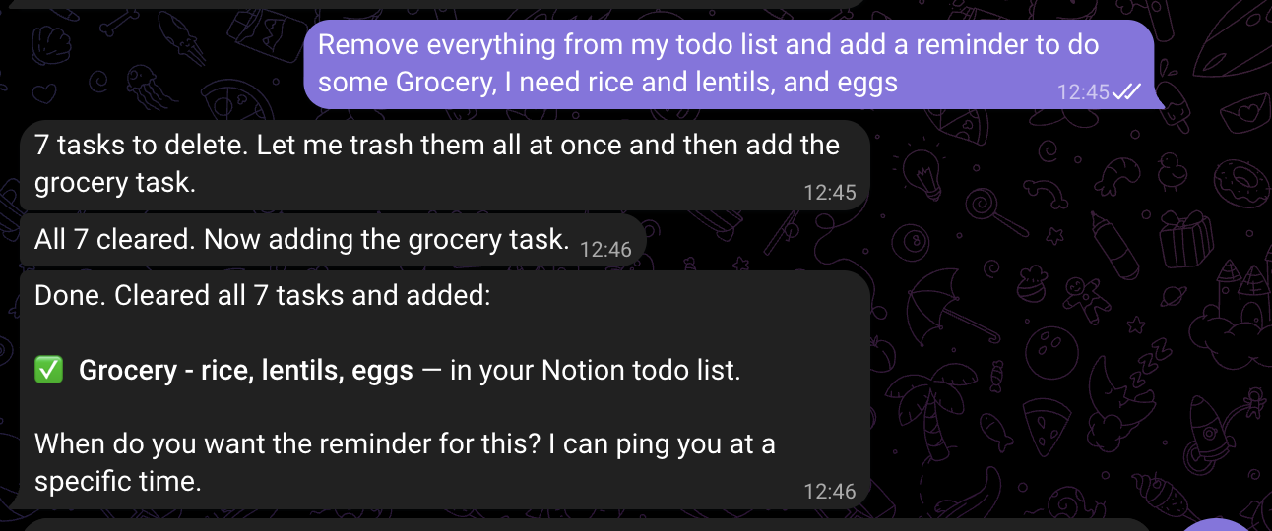
Openclaw in action

Slide 32
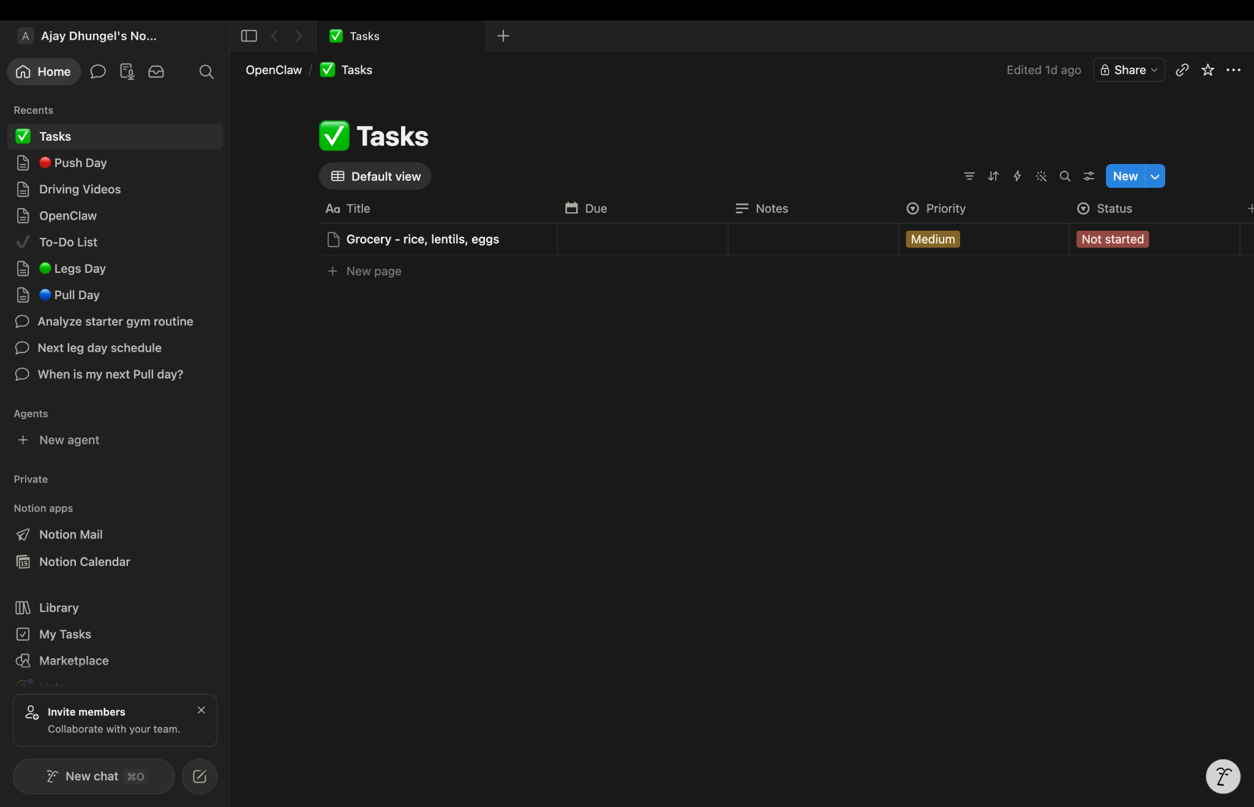
Openclaw in action

Slide 33
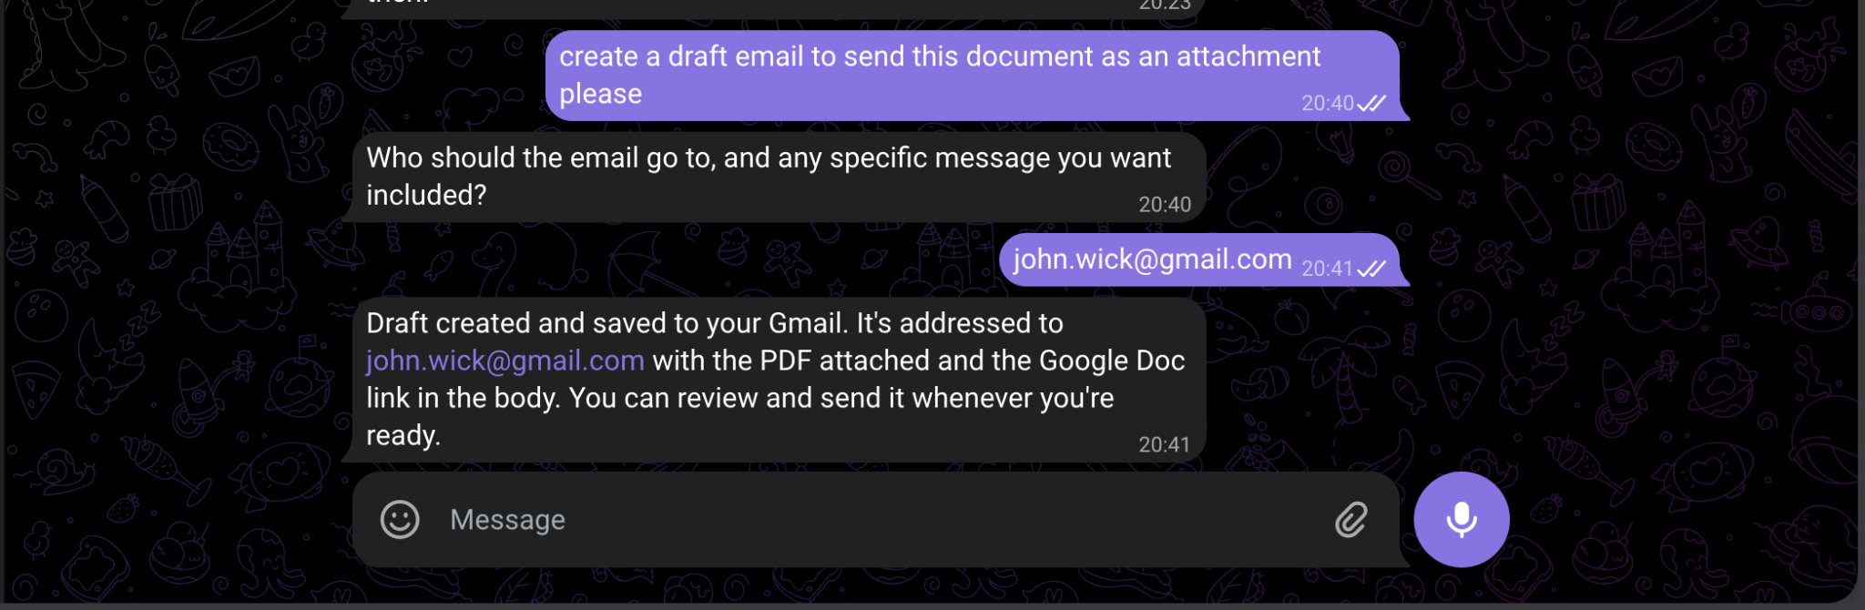
Openclaw in action

Slide 34
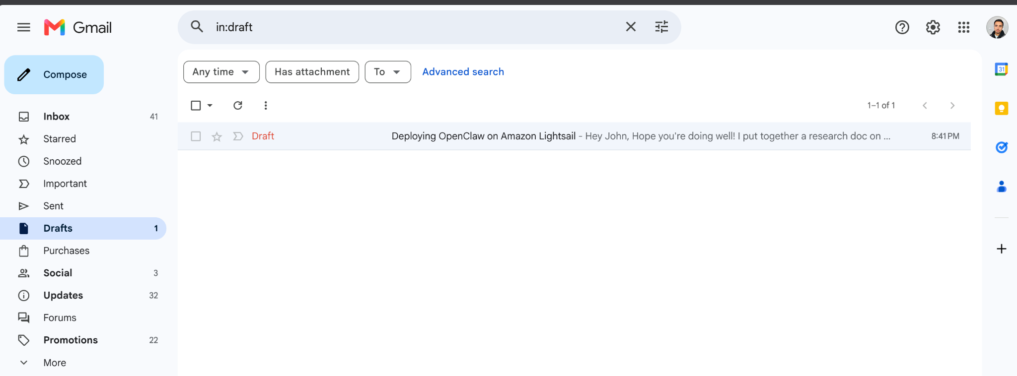
Openclaw in action

Slide 35
Lessons Learned
Getting started with OpenClaw is easier than you think
24/7 AI agent, no Mac Mini required
Minimum 4GB RAM, otherwise OpenClaw will be slow
Lightsail and Bedrock are billed separately
Fixed public IP, no port forwarding needed
Isolated and secure, your home network stays safe

Slide 36

Any Questions?

Slide 37
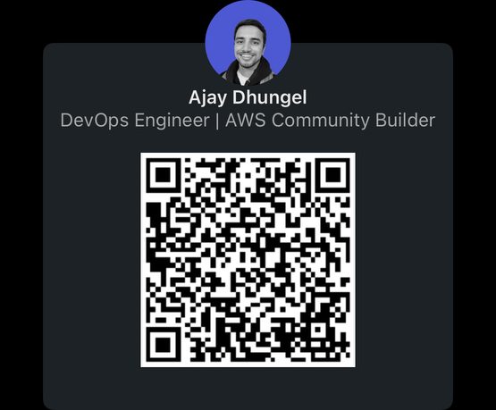
Thank you !
Connect with me on Linkedin

